Slide 1

AGEING WITH DIGNITY THROUGH GOOD PUBLIC POLICY
Aleš Kenda, MDDDZ, Belgrade, 11. Dec. 2018

Slide 2
POPULATION PYRAMID (Slovenia 1971-2061)

Slide 3
Inhabitants of the Republic of Slovenia - 2.067.284
Average age - 43,2 let
Share of the population, age 0-14 years - 15,0 %
Share of the population, age 15 – 64 years - 65,6 %
Share of the population, age 65 or more years - 19,4 %
Vir: SURS 2018

Slide 4
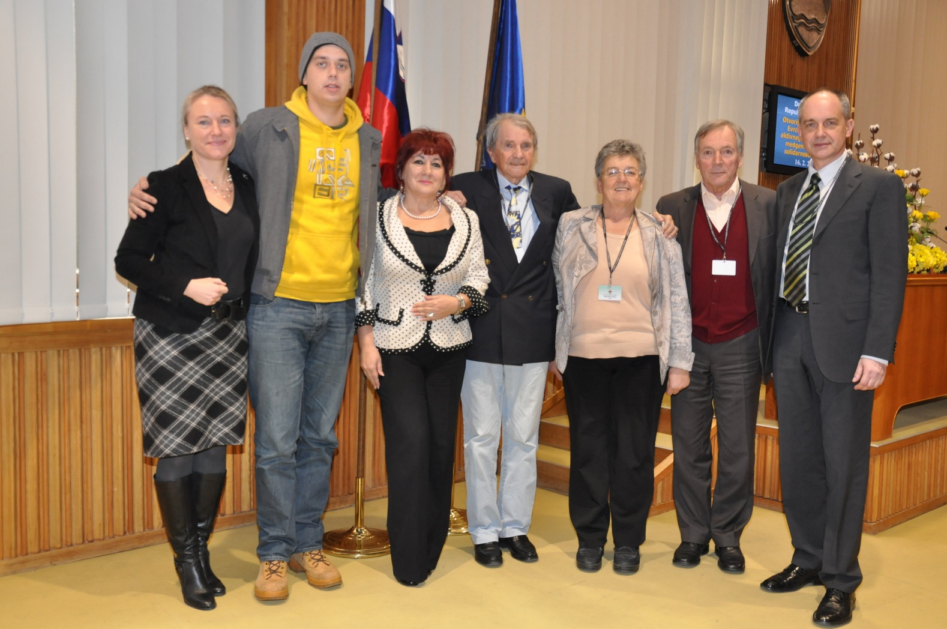

Slide 5
LONGER LIFESPAN - A SUCCESS STORY
EXPECTED AVERAGE LIFESPAN HAS INCREASED BY 30 YEARS IN THE LAST 100 YEARS
RESULT OF BETTER LIVING AND WORKING CONDITIONS, PROGRESS IN SCIENCE, BETTER HEALTH SUPPLIES, BETTER NUTRITION ...

Slide 6
AGEING OF THE POPULATION IS ONE OF THE GREATEST ACHIEVEMENTS OF OUR SOCIETY, BUT IT ALSO REPRESENTS ONE OF THE MOST IMPORTANT CHALLENGES.

Slide 7
History of strategies connected to demographic change in Slovenia
1997 STRATEGY OF THE CARE FOR THE ELDERLY
2006 STRATEGY OF SOLIDARITY, COEXISTENCE AND QUALITY AGEING OF THE POPULATION
2017 STRATEGY OF LONG LIVING SOCIETY (ACTIVE AGEING STRATEGY)

Slide 8
ACTIVE AGEING INDEX
Domain | Indicators
Employment | Employment rate 55-59 | Employment rate 60-64 | Employment rate 65-69 | Employment rate 70-74
Participation in Society | Voluntary Activities | Care for Children and grandchildren | Care to inform and disabled | Political participation
Independent Healthy and Secure Living | Physical excercise | Access to health services | Independent living | Financial security | Physical safety | Lifelong learning
Capacity and Enabling Environment for Active Ageing | Remaining life expectancy at age 55 | Share of healthy life expectancy at age 55 | Mental wellbeing | Use of ICT | Social connectedness | Educational attainment

Slide 9
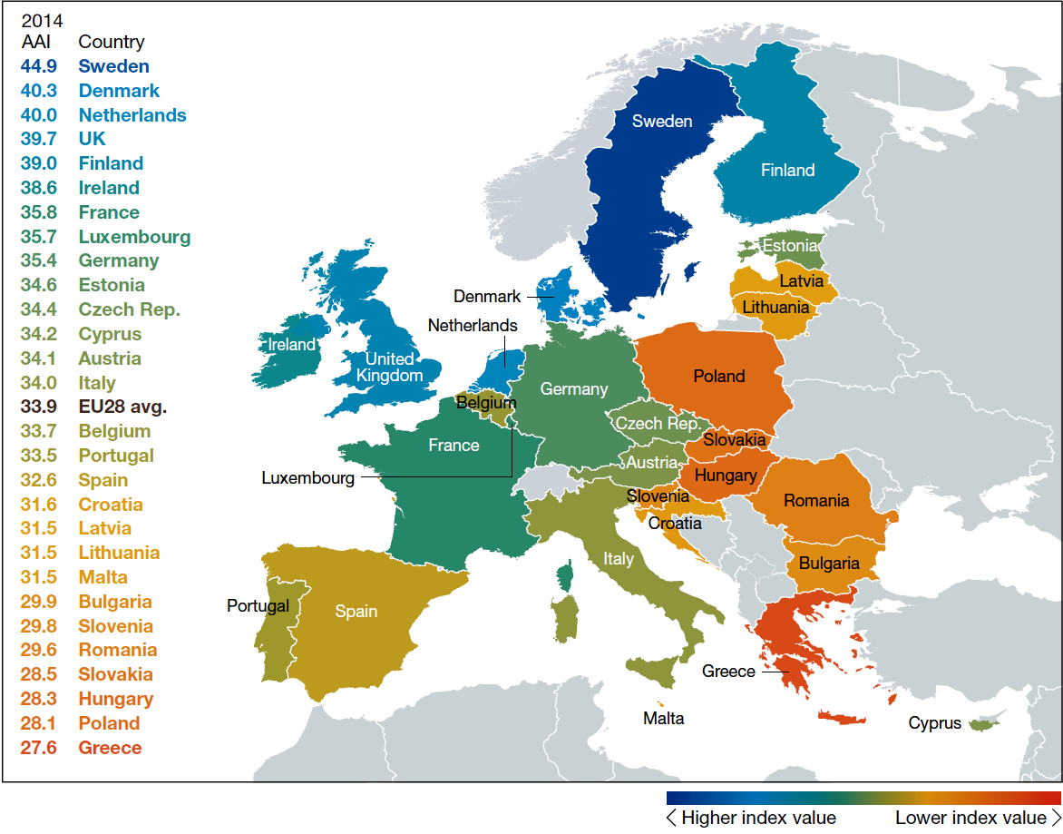
Source: UNECE

Slide 10
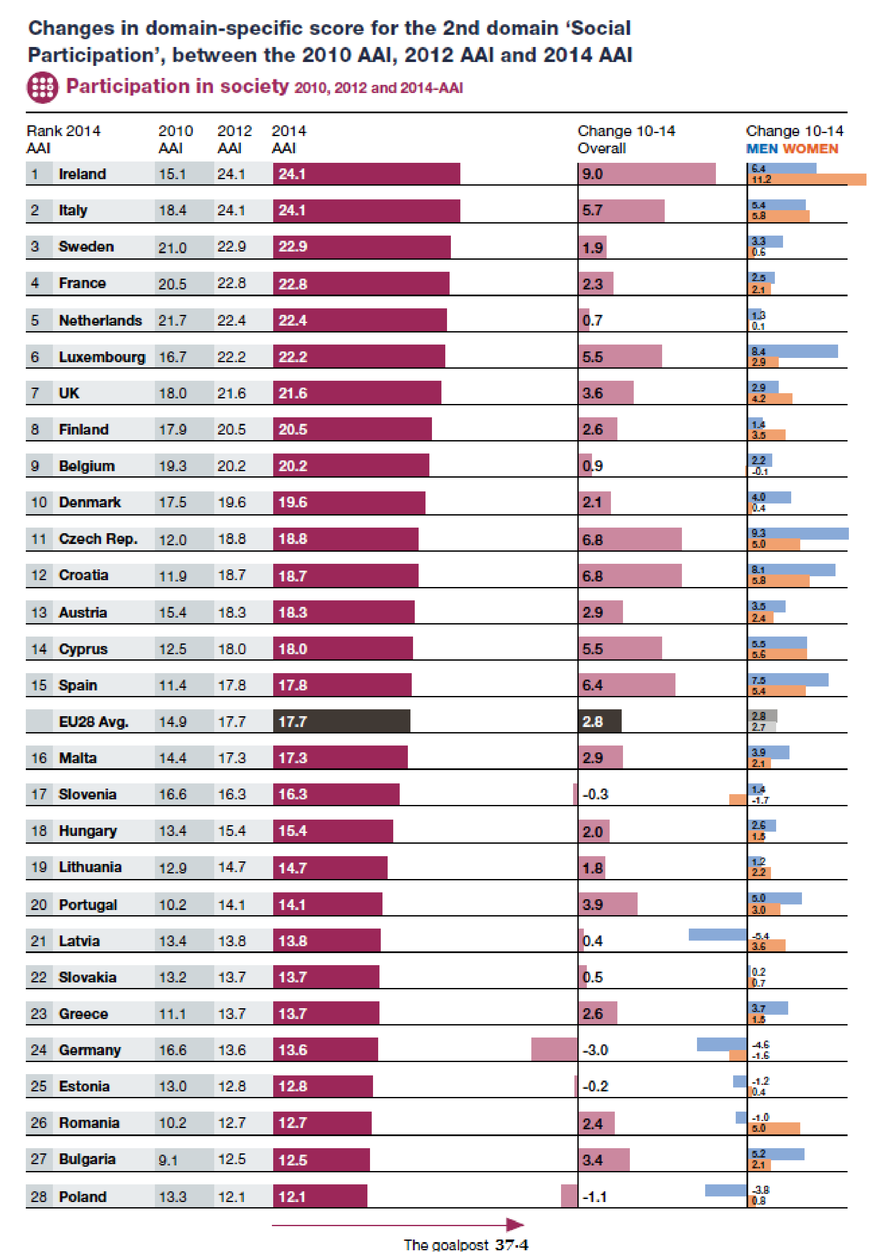

Slide 11
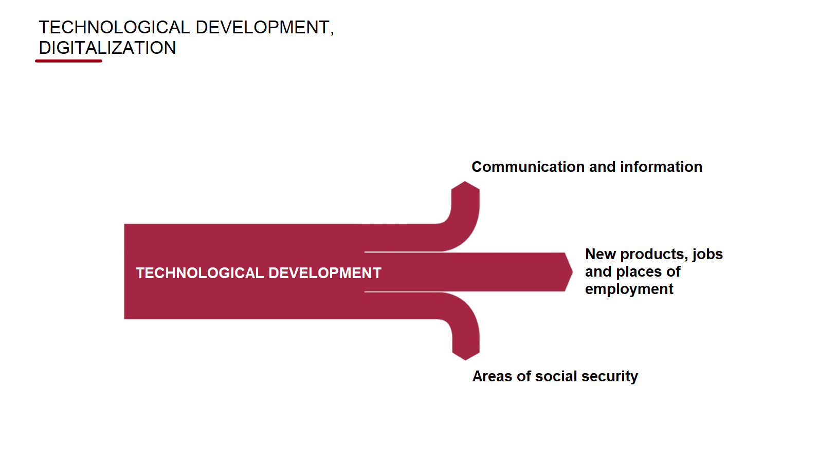
TECHNOLOGICAL DEVELOPMENT, DIGITALIZATION

Slide 12
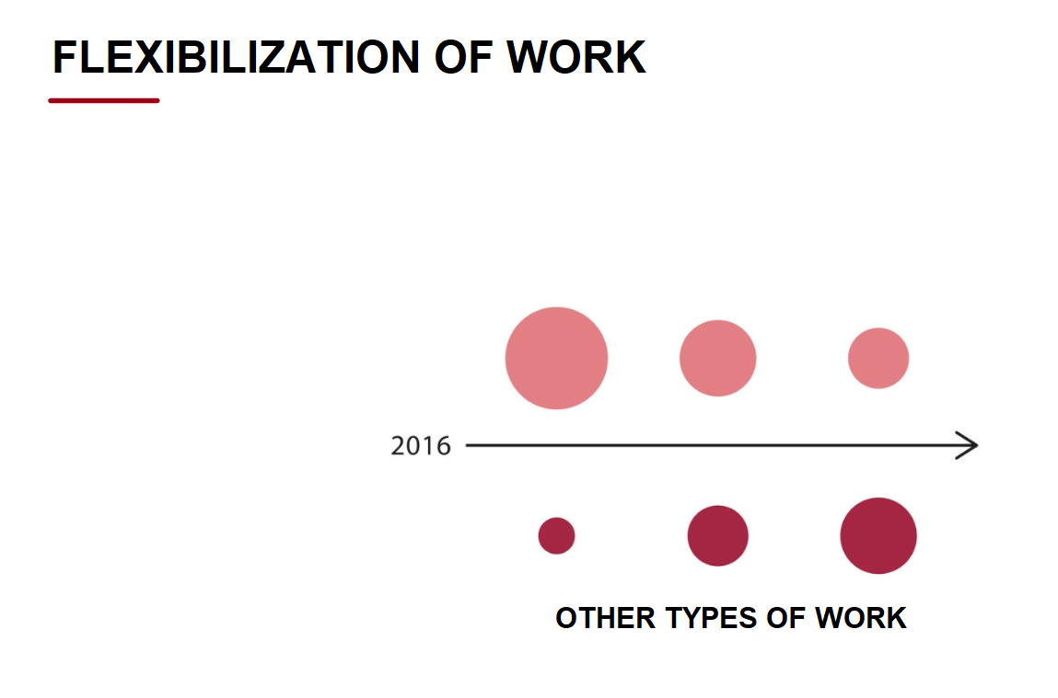
FLEXIBILIZATION OF WORK
PERMANENT EMPLOYMENT
FORMS

Slide 13
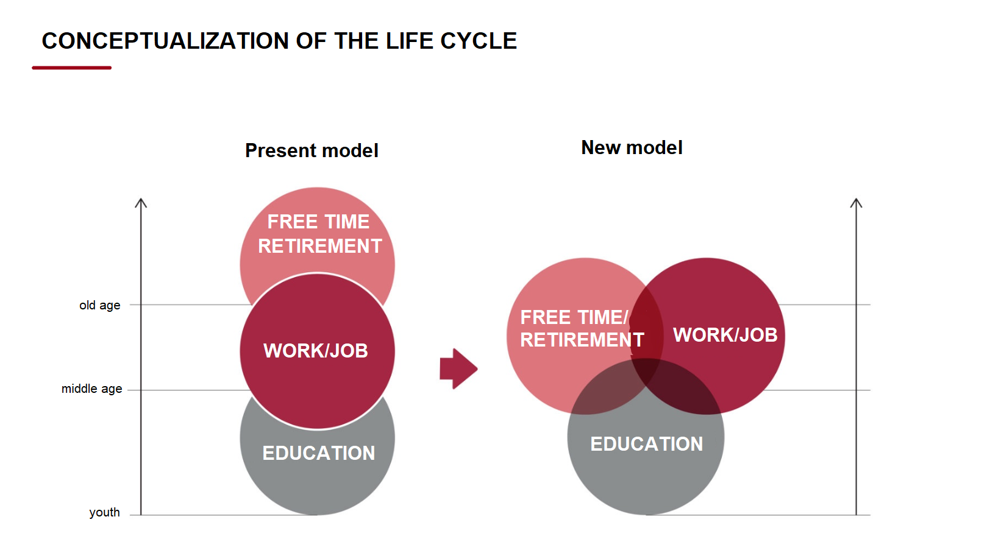
CONCEPT OF THE CHANGED LIFE CYCLE PROCESS

Slide 14
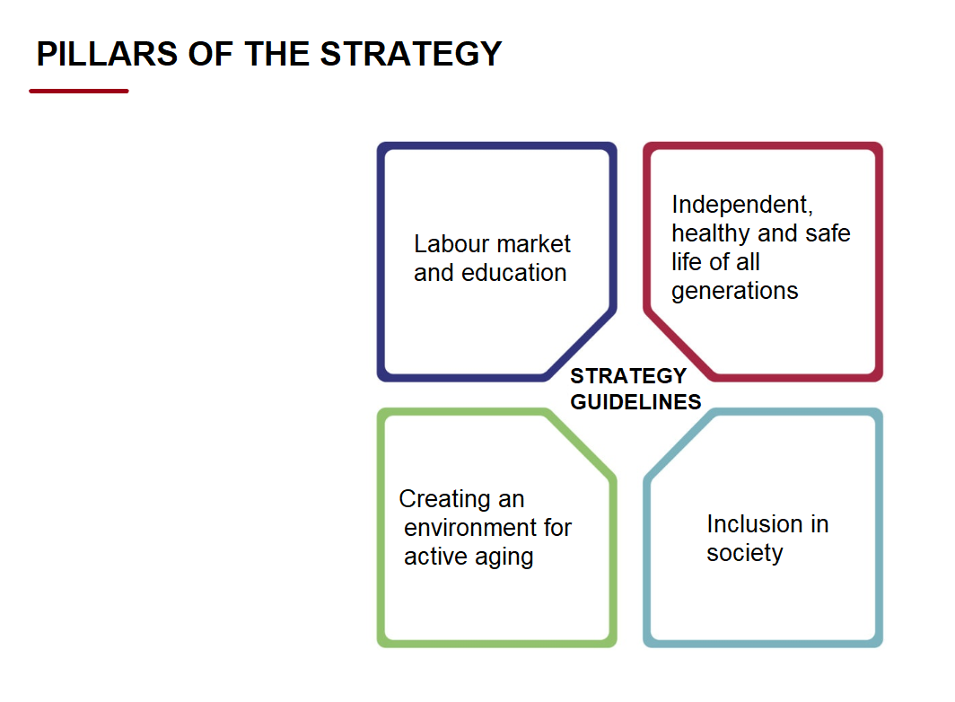

Slide 15
LABOUR MARKET AND EDUCATION
Provision of sufficient labor force,
Adjustment of jobs and working time,
Opportunities for job creation, Access to education and training
- Intergenerational transfer of knowledge and promotion of creativity
- Access to education and training

Slide 16
INCLUSION IN THE SOCIETY
ICT for better inclusion of older persons in society
Volunteering
Voluntary-hobby cultural and sport activities
Human rights of older persons, Age discrimination
Ageing with dignity
Political and civic engagement
Intergenerational cooperation and solidarity
Personal safety of older persons

Slide 17
CREATING A FRIENDLY ENVIRONMENT FOR ACTIVE AGEING
Informal carers
Adjustments to changes in consumption
Adaptation of living conditions
Changes in living habits (migration to cities and rural areas)

Slide 18
INDEPENDENT, HEALTHY AND SAFE LIFE OF ALL GENERATIONS
- Promoting a healthy life style
Reducing health inequalities
Adaptation of social protection systems (pension, health, long-term care)
Ensuring quality of life for families

Slide 19
TIPS IN STRATEGY
Active ageing (emphasizes activity and creativity in all stages of life, concern for health and intergenerational solidarity)
Informal carers
ICT
Rights of older persons, dignified ageing, non discrimination of older persons

Slide 20
ACTIVITIES AHEAD
Council for active ageing and solidarity between generations (established)
Action plans

Slide 21
Elderly for Elderly
The Slovenian Federation of Pensioners’ Organisations in 2004 started the project “Elderly people improving the quality of their lives and the lives of their peers with voluntary work (Elderly for Elderly)” project, creating a system whereby older volunteers visit older citizens in their neighborhood.

Slide 22
Dementia-friendly spots in Slovenia
Dementia-friendly spots are info points in the community that provide information on dementia, including how to detect first signs of dementia, how to communicate with a person with dementia and where to find additional support and services. The service is targeted at persons with dementia, their caregivers and actors in the local community such as police, firefighters, retailers, employees of banks, post offices, community health centres, hospitals and pharmacies.

Slide 23
INTERGENERATIONAL CENTERS (16):
- development and promotion of intergenerational volunteering;
- education and awareness;
- counseling and information, self-help groups, advocacy, telephone counseling, development of new services (Volunteer service);
- intergenerational learning, which promotes the transfer of know-how between generations in both directions;
- training on the topic of communication between generations;
- coordination of activities between different providers in the field of intergenerational cooperation, exchange of good practices, networking and integration;
- promotion of intergenerational cooperation.

Slide 24
AGE IS A PERIOD OF LIFE WHICH IS EQUIVALENT TO OTHER PERIODS; IT TAKES SOMETHING AWAY, BUT ON THE OTHER HAND, IT CAN GIVE US A LOT – DEPENDING ON OURSELVES

Slide 25
AGEING IS LIKE HIKING; WHEN YOU CLIMB, YOU MAY HAVE SOME BREATHING PROBLEMS, BUT WHEN YOU ARE AT THE SUMMIT, THE VIEW IS MORE BEAUTIFUL THAN IN THE VALLEY

