Slide 1

Global AgeWatch Insights
The right to health for older people, the right to be counted

Slide 2
Global AgeWatch Insights
Global AgeWatch Insights is a joint initiative of HelpAge and AARP. It is an 80-page report, executive summaries and 12 country profiles – Argentina, Colombia, El Salvador, Kenya, Lebanon, Moldova, Myanmar, Pakistan, Serbia, Tanzania, Vietnam and Zimbabwe. It aims:
To analyse older people’s right to health in the context of current demographic, epidemiological and health systems transitions;
To explore Universal Health Coverage (UHC) and relevant aspects of Agenda 2030 for Sustainable Development;
To consider how health systems can respond to ensure the availability, accessibility and quality of health services for older people;
To highlight issues related to the availability of data on ageing and on older people’s health, gaps in the collection, analysis and use of data;
To provide an overview of older people’s physical and mental health and shifting disease patterns in LMICs, highlighting key trends and the main health issues experienced by older women and men;
To provide recommendations on what is required to ensure more inclusive health and data systems which are enabling of older people’s right to health and fit for purpose in an ageing world.

Slide 3
Ageing and population health
By 2020, the number of people in the world aged 60 and over is projected to pass the one billion mark, and to reach two billion by 2050.This is contributing to a shift towards non-communicable diseases (NCDs).
This year, as we celebrate the 70th anniversaries of the Universal Declaration of Human Rights and the founding of the World Health Organization, older people are not being counted in key data, and risk being left behind.
As the world’s population ages, health systems need to adapt to ensure older women and men can realise their right to health. The global drive towards universal health coverage is an opportunity to strengthen health systems and meet the commitment of the Sustainable Development Goals to ensure healthy lives and wellbeing for all at all ages.

Slide 4
Key findings
Data systems designed to inform the planning and delivery of health services systematically exclude older people.
Older people are prevented from accessing health services by cost, lack of transport, discrimination, and inadequate training of health workers.
Although women are living longer, they live more years in poor health, and with disability, depression and dementia.

Slide 5
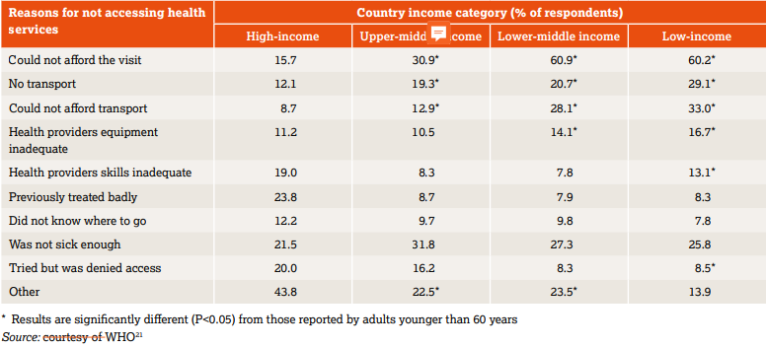
Why over 60s can’t access health

Slide 6
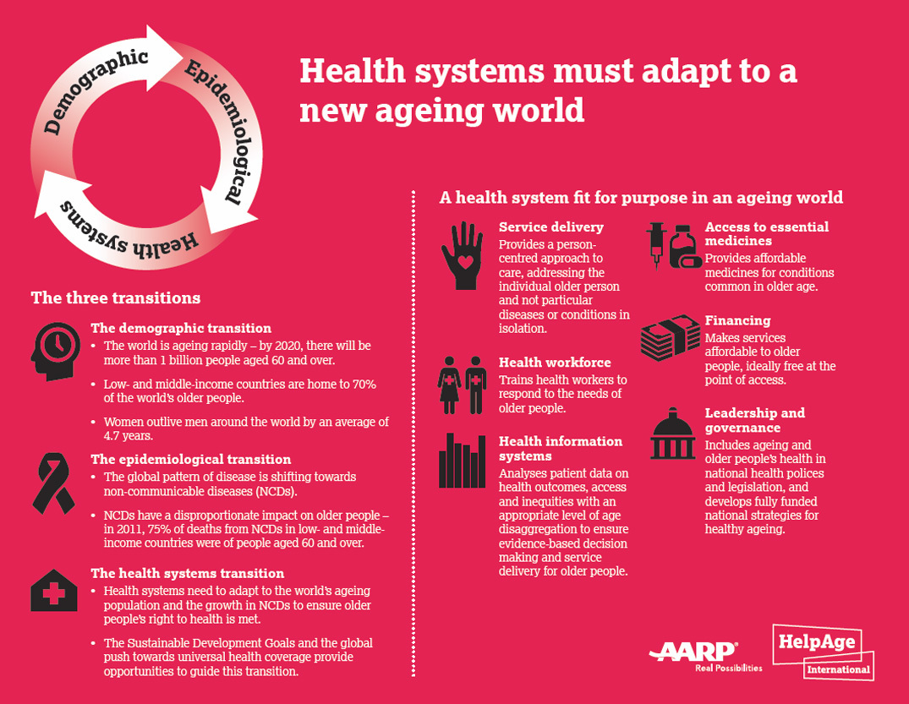

Slide 7
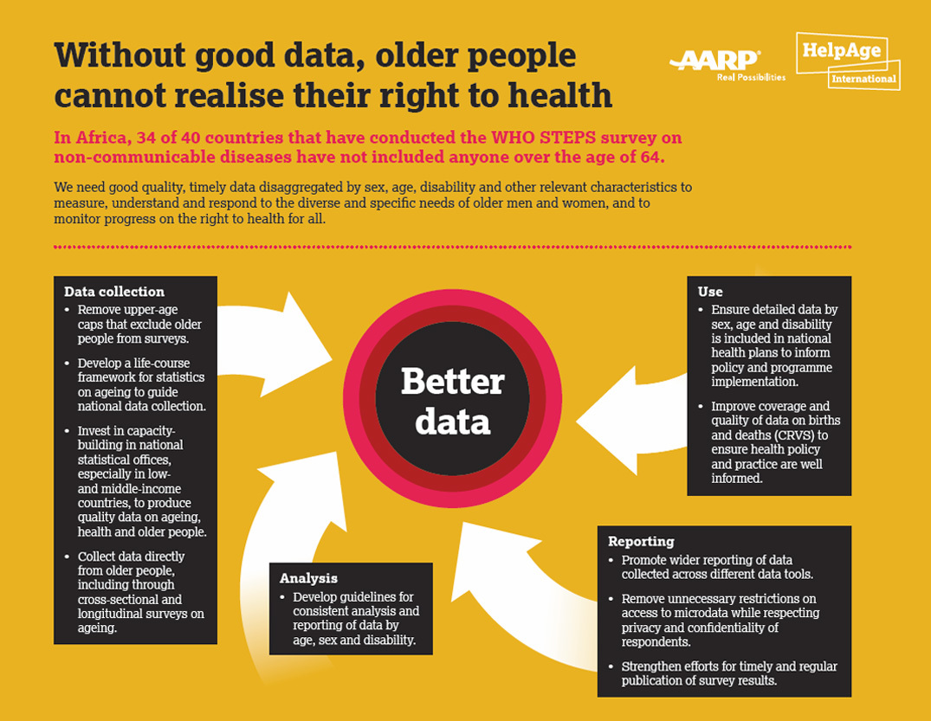

Slide 8
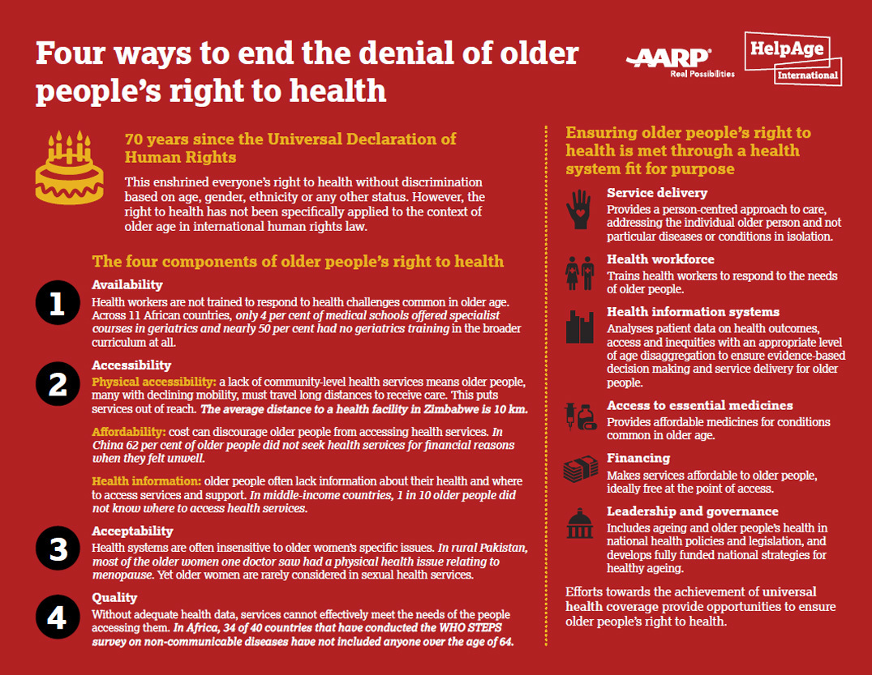

Slide 9
Key recommendations
Universal health coverage for all at all ages
Improved access to services including prevention, diagnosis and treatment of disease among older men and women.
Training for medical staff and health workers to understand older people’s health issues and effectively treat them, and to end ageist attitudes that can deter them from seeking medical help.
Make health facilities physically accessible and ensure financial costs of care do not deter older people from seeking help.
Develop detailed high-quality data that include older people’s experiences to inform design and running of health systems.

Slide 10
Action for change
Participation of older people
Working in partnership
Achieving health systems transition
Inclusion of ageing in policy, law and practice
Mental & cognitive health on equal footing with physical health
Models of UHC, person-centred, integrated, holistic
Addressing data issues and gaps
Remove upper age caps
Broaden access to data that is collected
Invest in capacity of national statistical offices
Improve coverage and quality of CRVS

Slide 11
