Slide 1
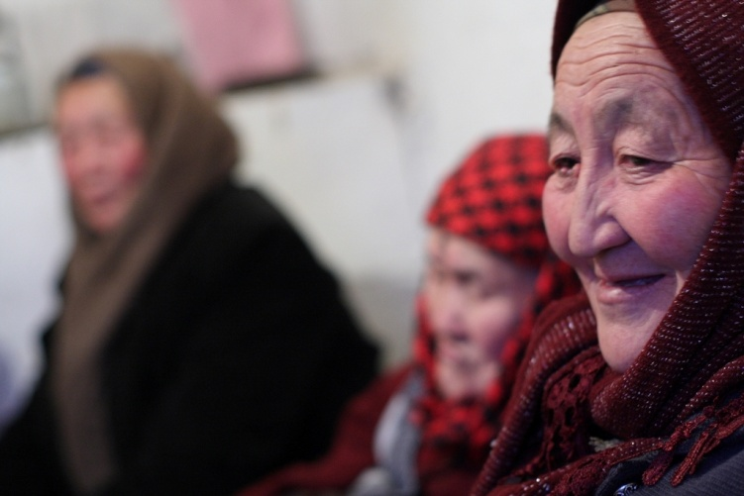

Living not just surviving: Human rights and social inclusion
Bridget Sleap, HelpAge International, 11th December 2018
Notes:
Start with some top line info and background, links to our work and the proces
Significance of the SDGs for our network members, focus of the work and approach going forwards

Slide 2
Rights at the 10th Open-ended
Working Group on Ageing, April 2019
Social security and social protection (including social protection floors)
Education, training, lifelong learning and capacity building
=
Empowerment rights

Slide 3
Consultation with older people
539 older people
348 women and 191 men
23 countries:
Argentina Cambodia Denmark Finland Jordan Kenya Kyrgyzstan Lesotho | Mauritius Moldova Mongolia Myanmar Nepal Russian Federation Rwanda Serbia | Slovenia South Africa Sudan Tajikistan Tanzania Ukraine Zambia

Slide 4
What older people say
It is so little, it is impossible to survive on it.
81-year-old man, Kenya
It’s like they give pocket money for older people.
80-year-old woman, Myanmar
Some staff of some institutions don’t have adequate patience or interest to be working with older people.
78-year-old-woman, Serbia
My son taught me how to use my phone and google, and I really like it! When a question pops into my mind, I just type it in and get loads of answers!
65-year-old woman, Jordan

Slide 5
The right to social security and social protection
My pension is insufficient even for bare survival and anything else would be way beyond my reach if my husband didn’t have a decent salary.
67-year-old woman, Serbia
Well, yes, I do have full control but what is the point of having full control over such a small pension that is barely enough for extremely basic things?
74-year-old man, Jordan
Since I am bedridden, the person paid to care for me has power of attorney. I cannot control all the payments made. It makes me feel powerless.
88-year-old woman, Moldova

Slide 6
Social security and social inclusion
It is not enough as I have to buy disposable napkins [diapers] because sometimes urine just drips out and my trousers become wet. I feel very embarrassed.
86-year-old-man, South Africa
I would like to buy a goat and even get someone to plough for me, but I can’t.
81-year-old man, Kenya
I cannot afford to go to cultural events, social calls with my peers, and cannot afford to buy presents for anyone.
66-year-old woman, Serbia
I miss doing sports activities, but you know how it is these days, you have to pay for everything.
68-year-old man, Slovenia

Slide 7
The right to lifelong learning and
education
Education helps to prepare for life in new conditions and participate in public life.
Russian Federation, group discussion.
We can only receive information from each other. If you have a wider social circle, then there is information. If you are alone, you are very far behind the times.
68-year-old woman, Kyrgyzstan
We have never tried. We don’t have an idea of where to start.
Lesotho, group discussion

Slide 8
Lifelong learning and social inclusion
IT: pay bills; schedule doctors appointments; shop; bank; book tickets; stay in touch with family
Health, exercise, nutrition
Make money
Manage finances
Public life – law, politics, human rights, advocacy, campaigning
Set up associations
Recreation and leisure

Slide 9
A new UN convention on the rights
of older people
To set out how human rights apply in older age
We understand our human rights
States understand their obligations
End ageism in implementation of human rights

Slide 10
The right to social security and social
protection in a new UN convention
Older people have the right to social security and social protection without discrimination based on age or any other ground, so they can live autonomous and independent lives with dignity and fully participate in society.

Slide 11
The right to lifelong learning and
education in a new UN convention
Older people have the right to lifelong learning and education on an equal basis with others and without discrimination, so they can live autonomous and independent lives, fulfil their aspirations, build their skills and capacities, develop their full human potential and sense of dignity and self-worth, and participate fully in society.

Slide 12
Conclusions
Human rights are critical for older people’s social inclusion
Purpose of human rights: Not just to survive but to fully participate in society
Older people’s rights need to be set out in a new UN convention on the rights of older people

