Slide 1
Taking Action On Social Inclusion Of Older People
Networking and the importance of networks in advocating for better quality of life of older people
Belgrade, Serbia
11- 12 December 2018

Slide 2
HELPAGE GLOBAL NETWORK

Slide 3
TOGETHER WE ARE STRONGER

Slide 4
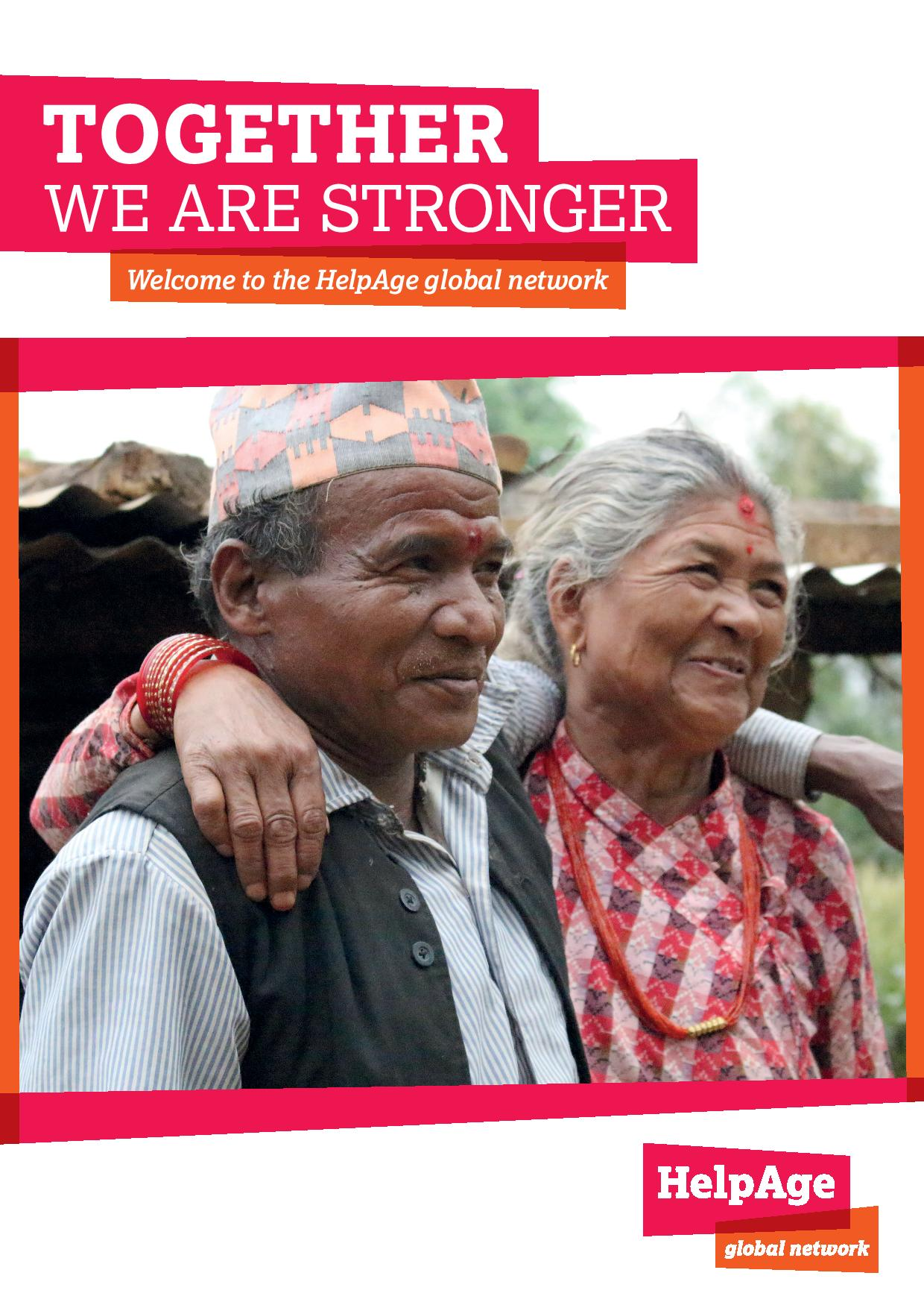
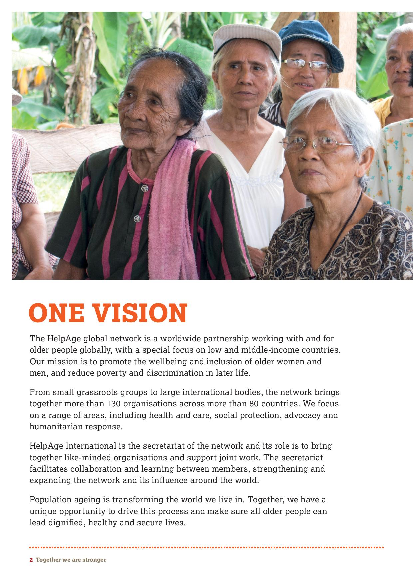

Slide 5
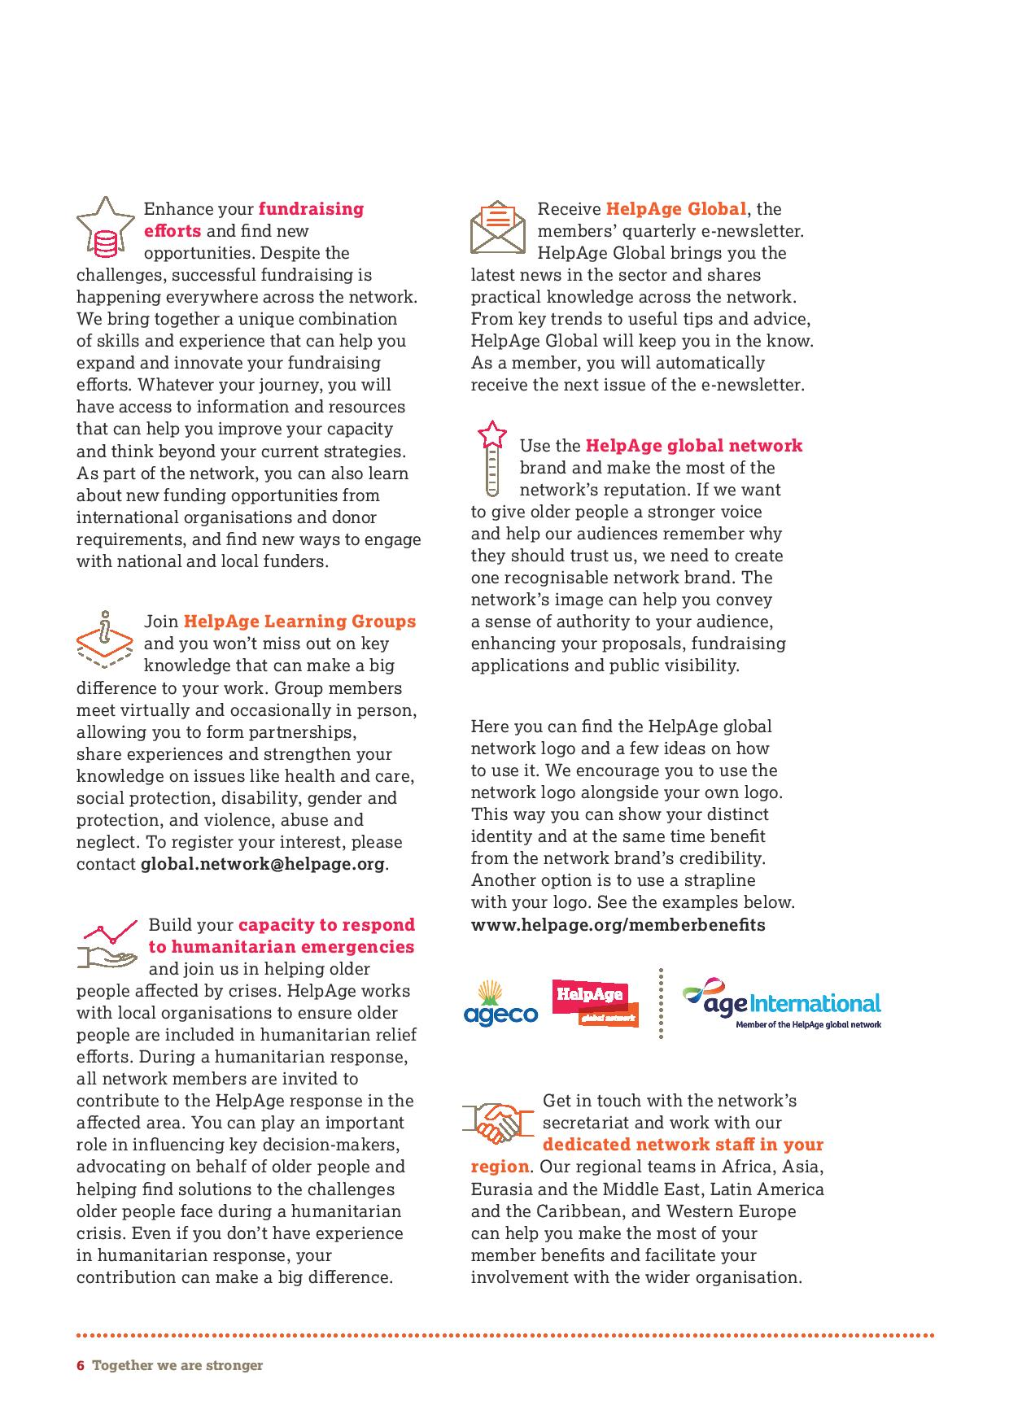
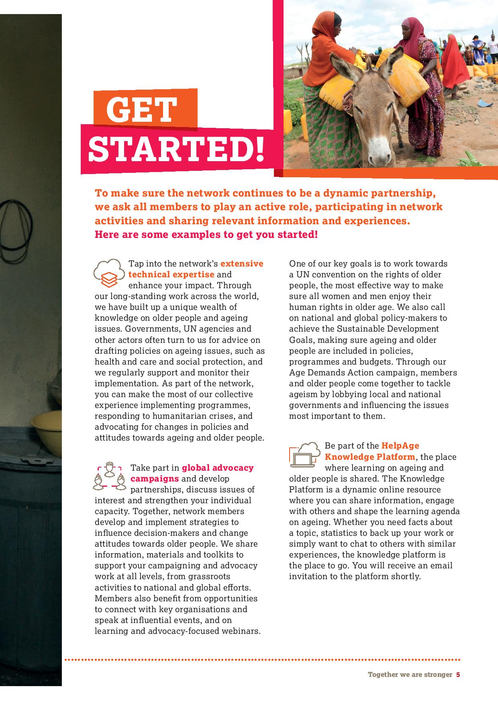
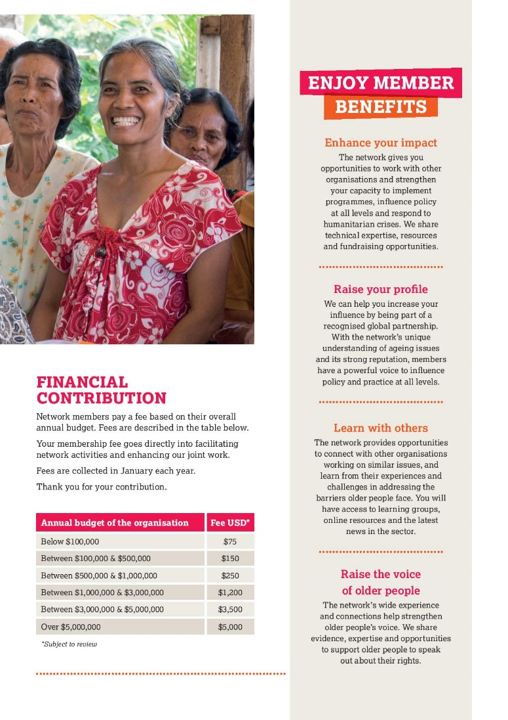
HelpAge Global Network

Slide 6
OUR VISION
The HelpAge global network is a worldwide partnership working with and for older people globally, with a special focus on low and middle-income countries.
Our mission is to promote the wellbeing and inclusion of older women and men, and reduce poverty and discrimination in later life.
From small grassroots groups to large international bodies, the network brings together more than 139 organisations across more than 83 countries.
We focus on a range of areas, including health and care, social protection, advocacy and humanitarian response.
HelpAge International is the secretariat of the network and its role is to bring together like-minded organisations and support joint work.
The secretariat facilitates collaboration and learning between members, strengthening and expanding the network and its influence around the world.
Population ageing is transforming the world we live in. Together, we have a unique opportunity to drive this process and make sure all older people can lead dignified, healthy and secure lives.

Slide 7
Membership benefits
Enhance members’ impact
The network gives the members opportunities to work with other organisations and strengthen their capacity to implement programmes, influence policy at all levels and respond to humanitarian crises. We share technical expertise, resources and fundraising opportunities.
Raise members’ profile
We can help members increase their influence by being part of a recognised global partnership. With the network’s unique understanding of ageing issues and its strong reputation, members have a powerful voice to influence policy and practice at all levels.

Slide 8
Membership benefits
Learn with others
The network provides opportunities to connect with other organisations working on similar issues, and learn from their experiences and challenges in addressing the barriers older people face. members will have access to learning groups, online resources and the latest news in the sector.
Raise the voice of older people
The network’s wide experience and connections help strengthen older people’s voice. We share evidence, expertise and opportunities to support older people to speak out about their rights.

Slide 9
Members’ engagement in network activities
The network continues to be a dynamic partnership, we ask all members to play an active role, participating in network activities and sharing relevant information and experiences. Here are some examples
Members make use of the network’s extensive technical expertise and enhance their impact.
Through our long-standing work across the world, we have built up a unique wealth of knowledge on older people and ageing issues.
Governments, UN agencies and other actors often turn to us for advice on drafting policies on ageing issues, such as health and care and social protection, and we regularly support and monitor their implementation.
As part of the network, members can make the most of our collective experience implementing programmes, responding to humanitarian crises, and advocating for changes in policies and attitudes towards ageing and older people.

Slide 10
Members’ engagement in network activities
Members take part in global advocacy campaigns and develop partnerships, discuss issues of interest and strengthen their individual capacity.
Together, network members develop and implement strategies to influence decision-makers and change attitudes towards older people.
We share information, materials and toolkits to support their campaigning and advocacy work at all levels, from grassroots activities to national and global efforts. Members also benefit from opportunities to connect with key organisations and speak at influential events, and on learning and advocacy-focused webinars.

Slide 11
Members engagement in network activities
One of our key goals is to work towards a UN convention on the rights of older people, the most effective way to make sure all women and men enjoy their human rights in older age.
We also call on national and global policy-makers to achieve the Sustainable Development Goals, making sure ageing and older people are included in policies, programmes and budgets.
Through our Age Demands Action campaign, members and older people come together to tackle ageism by lobbying local and national governments and influencing the issues most important to them.

Slide 12
Members engagement in network activities
Enhance members’ fundraising efforts and find new opportunities.
Despite the challenges, successful fundraising is happening everywhere across the network. We bring together a unique combination of skills and experience that can help members expand and innovate their fundraising efforts. Whatever their journey, they will have access to information and resources that can help them improve their capacity and think beyond their current strategies. As part of the network, they can also learn about new funding opportunities from international organisations and donor requirements, and find new ways to engage with national and local funders.
Receive HelpAge Global members’ quarterly e-newsletter. HelpAge Global brings members the latest news in the sector and shares practical knowledge across the network. From key trends to useful tips and advice, HelpAge Global will keep members in the know.

Slide 13
Members engagement in network activities
Build members’ capacity to respond to humanitarian emergencies and join us in helping older people affected by crises.
HelpAge works with local organisations to ensure older people are included in humanitarian relief efforts. During a humanitarian response, all network members are invited to contribute to the HelpAge response in the affected area.
Members can play an important role in influencing key decision-makers, advocating on behalf of older people and helping find solutions to the challenges older people face during a humanitarian crisis.

Slide 14
HelpAge International Theory of Change
The Theory of Change highlights the four core interconnected approaches we use to achieve impact on our thematic priorities, working with the network.
Advocating for Change: We advocate and campaign for change as a network, which enables us to bring our collective experience to bear on policy and wider public attitudes towards older people and ageing.
Programme Delivery: We deliver programmes with network members to enable us to develop and test service delivery models for older people in a practical way, including responding to humanitarian crises.
Strengthening Voice: We actively strengthen older people’s voices and the collective voice of network members through a variety of interventions at national, regional and international levels.
Knowledge and Evidence: We take an active approach to learning as a network based on the evidence we and our network members generate through programming and policy work, and use this knowledge to inform global debates on ageing, influence change and improve our own practice.

Slide 15
Examples of how HelpAge Global Network improved quality of life of older people
Advocating for Change: In April 2016, Zanzibar made history when it became the first government in East Africa to provide a state-funded universal pension for older people. Every woman or man aged 70 or above receives a monthly pension of TZ Shillings 20,000, or around $9. This change in policy can be directly attributed to many years of credible, evidence-based advocacy work by the HelpAge team in Tanzania, working hand in hand with a coalition of network members in Zanzibar.
Programme Delivery: We supported network member COSE to reach 200,000 people with relief activities in the aftermath of Typhoon Haiyan, which hit the Philippines in November 2013. HelpAge International provided technical support and operational capacity to enable COSE to deliver a large scale humanitarian response benefiting older people.
Strengthening Voice: Through consistent network development and relationship building, we have developed the Platform for Active Ageing in Moldova which features 15 different organisations with a variety of expertise on ageing and older people. The Platform for Active Ageing collaborates to influence government ministries in key policy areas. We have recently received funding from the German Government for a three-year project to take forward work aiming to reduce the prevalence and impact of age and gender based violence.
Knowledge and Evidence: HelpAge is implementing a large scale project in Myanmar to strengthen the ability of the University of Public Health to contribute to evidence-based policymaking around non-communicable diseases (NCDs) in the country. The project will draw on the technical expertise of several partners in addition to HelpAge including Thammasat University’s Faculty of Public Health, Thailand, and the World Health Organisation.

Slide 16
National networks and HelpAge Global Network
National networks are encouraged to engage in global advocacy and thematic initiatives working in their countries and supported by HelpAge International. These initiatives that are dedicated to:
Promoting and advocating for universal social pensions
Our goal of universal pension coverage can be achieved through a mix of approaches (contributory/tax-financed) but universal social pensions are a priority in most contexts.
The concept for social protection floors is the most up-to date-rights based normative standard for life cycle social protection systems and is a guiding framework for HelpAge work.
Our work prioritizes action at the national level, based on our experience that this the best approach to achieve change in social protection policy and implementation.
Ways of working:
Advocating for change: We want to shift broader thinking on social protection (beyond older people) by advocating for a life cycle system. While putting older people at the heart of our advocacy, we also seek to showcase the impacts of pensions on all generations.
Technical support and evidence: We will continue being a technical player in this sector, emphasising our skill in building trust with governments

Slide 17
National networks and HelpAge Global Network
2. Promoting and advocating for universal health coverage
HelpAge wants to move away from a sole focus on the presence or absence of disease to look at healthy ageing, wellbeing, independence and functional ability. Priority areas of work are outlined in the programme offer, based on our theory of change, and include: training health workers and community-based carers; responding to needs of older people in emergencies; promoting national implementation of the WHO Global Strategy and Action Plan (GSAP) on Ageing and Health; building evidence on UHC and older people / population ageing; Health Outcomes Tool roll out and used; Global AgeWatch Insights report on older people’s health in relation to UHC; growing OCM on health and care.
WAYS OF WORKING:
Shifting focus from disease/curative approach towards promotion of good health, functional ability and wellbeing, exploring convergence/integration of health and social care.
All programme delivery work explicitly linked with and informed by our advocacy objectives, focusing on changes we want to see at health system and policy levels (theory of change).
Increased focus on data collection and utilisation from our programmes, including digital.
Strengthened learning between regions and across the network through the health and care working group and knowledge platform.

Slide 18
National networks and HelpAge Global Network
3. Challenging ageism
Older people, ADA partners and network members recognise ageism and are empowered to take individual and collective campaign action against it
Develop a global narrative about ageism and challenge through grassroot action
HelpAge staff, ADA partners & network members invested in global campaign to address ageism
WAYS OF WORKING:
Leadership training/capacity building/awareness raising with ADA partners and older people
Collaborate with the WHO, contribute to the work of the global coalition convened by the WHO.
Convene the Global Campaigners Against Ageism to disseminate campaign news and actions across HelpAge and the network
Develop joint projects with network members to gather knowledge and evidence
Focus on ageism in health and care; audits of ageism and age-based discrimination in policy
Develop a range of tools to support work on ageism (research, policy briefings, awareness)

Slide 19
National networks and HelpAge Global Network
4. Strengthening the voice of older people and make them heard
Older women and men, including those with disabilities, their caregivers, their dependents and those facing intersectional discrimination, are able to fully enjoy their rights, are safe and secure, and free from all forms of, and the threat of, violence, abuse and neglect so that they are safe to pursue a life of dignity and continued development, including in time of crisis. Protection and inclusion will be central to the work of HelpAge as they are crucial to saving lives, alleviating suffering and enhancing human dignity.

Slide 20
National networks and HelpAge Global Network
To achieve this we will:
Ensure Protection Mainstreaming Approach is well understood and effectively applied in all humanitarian responses regardless of the sector
Build the capacity of the Network to deliver a quality protection response based on HelpAge model
Work closely with Protection cluster at global and national level to ensure protection needs of older women and men including those with disabilities are identified and addressed
Build a global programme of work on VAN through development and implementation of a holistic model of interventions (multi-sectoral and integrated at all levels)
Prioritise action research to pilot VAN research tool together with response and prevention interventions (including but not limited to case management approach, referral systems, psycho-social support and improving access to age, gender and disability friendly services).

