Slide 1
Promoting Quality of Life and
Active Ageing in Austria
AGEING WITH DIGNITY THROUGH GOOD PUBLIC POLICY
Belgrade December 11 2018
Erika Winkler
Federal Ministry of Labour, Social Affairs, Health and Consumer Protection

Slide 2
International and national mission
2002 UN International Plan of Action on Ageing
2002 UNECE Regional Implementation Strategy
2008 UNECE Working Group on Ageing
2012 European Year on Active Ageing and Solidarity between Generations
2012 3rd UNECE Minister Conference on Ageing: Promoting Quality of Life and Active Ageing
Federal Plan for Senior Citizens: Ageing and the Future
2017 4th Minister Conference: Realizing the Potential of Living Longer
TAKING ACTION ON SOCIAL INCLUSION OF OLDER PEOPLE

Slide 3
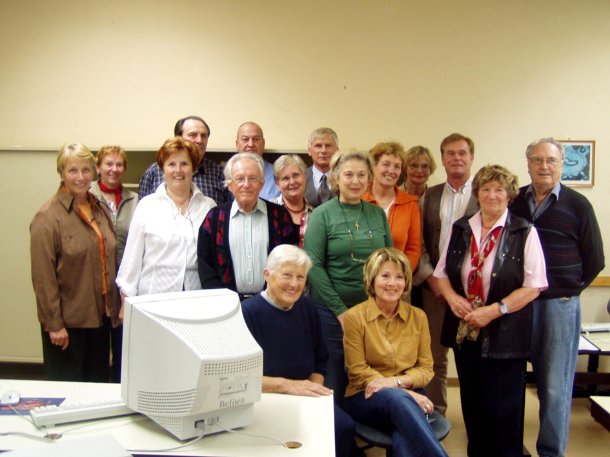
Active Ageing Strategy
4 Main Goals
Longer working life and ability to work
Participation, non-discrimination and social inclusion
Dignity, health and independence in older age
Intergenerational dialogue and solidarity
TAKING ACTION ON SOCIAL INCLUSION OF OLDER PEOPLE

Slide 4

Longer Working Life and Ability to Work
Austrian Strategy „Fit2Work“
Consultancy of enterprises and employees
Sustainable improvement of ability to work
Prevention of early retirement
Stable integration of employees with health problems
Awareness-building to prevent non-communicable diseases
Promoting healthy working places
TAKING ACTION ON SOCIAL INCLUSION OF OLDER PEOPLE

Slide 5

Longer Working Life and Ability to Work
Amendment to Act on Health and
Safety at Work
Protection of psychological health at work
Federal Guideline „Impulse Consulting of Enterprises“
Awareness Building Campaign „Einstellungssache 50+“
NESTOR-GOLD Seal of Quality for intergenerational age-management
Rehabilitation instead of retirement
TAKING ACTION ON SOCIAL INCLUSION OF OLDER PEOPLE

Slide 6
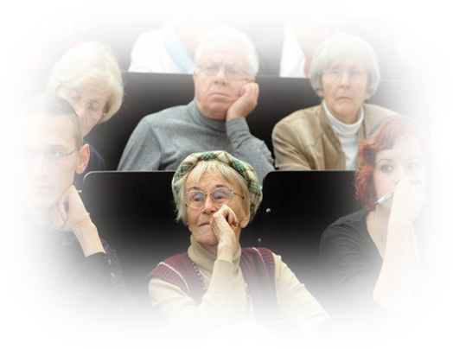
Participation, Inclusion,
Non-Discrimination
Austrian Federal Law on Senior Citizens 1998
Federal Senior Citizens’ Advisory Council
2000: Council of Senior citizens’ organizations ->
Status of a social partner
2012 Federal Plan for Senior Citizens „Ageing and the Future“
TAKING ACTION ON SOCIAL INCLUSION OF OLDER PEOPLE

Slide 7
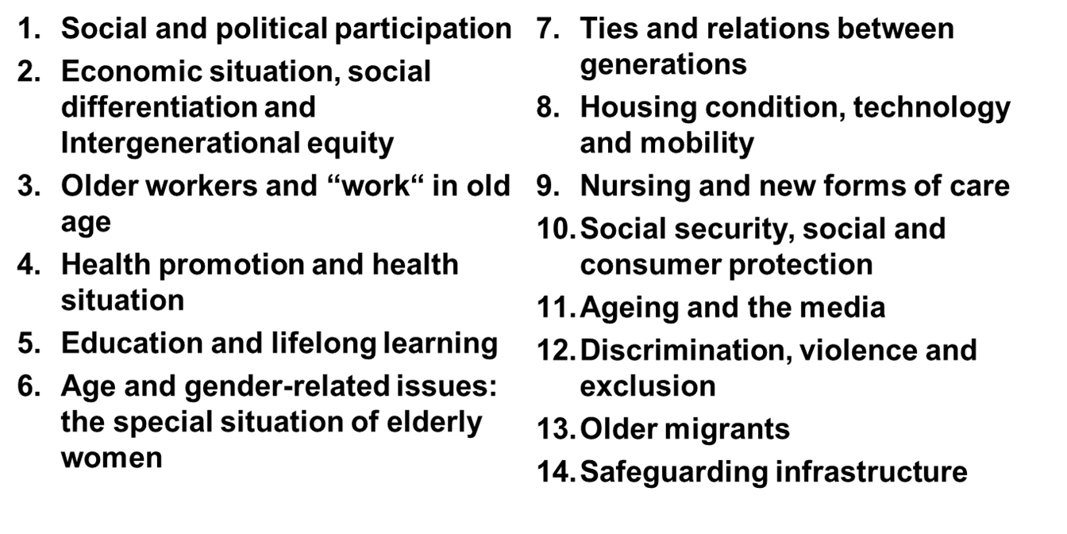
Participation, Inclusion, Non-Discrimination
Federal Plan for Senior Citizens - 14 Key Areas
TAKING ACTION ON SOCIAL INCLUSION OF OLDER PEOPLE

Slide 8
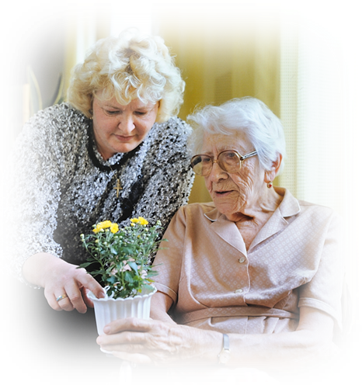
Dignity, Health and Independence
Long Time Care Benefit Act 1993
approx. 450.000 people receiving a care allowance –
Granted in 7 Levels
80% of all people in need of care are cared for at home:
59% of care allowance recipients are cared for at home
23% at home with the support of mobile services, domestic care, home-help, meals on wheel, geriatric day care centres
16% in nursing homes,
2% of care allowance recipients take a 24-hour assistance;
Project: Healthy and Active Ageing through Social Inclusion – Health Promotion, Health Literacy and Equal Opportunities for Older People
TAKING ACTION ON SOCIAL INCLUSION OF OLDER PEOPLE

Slide 9
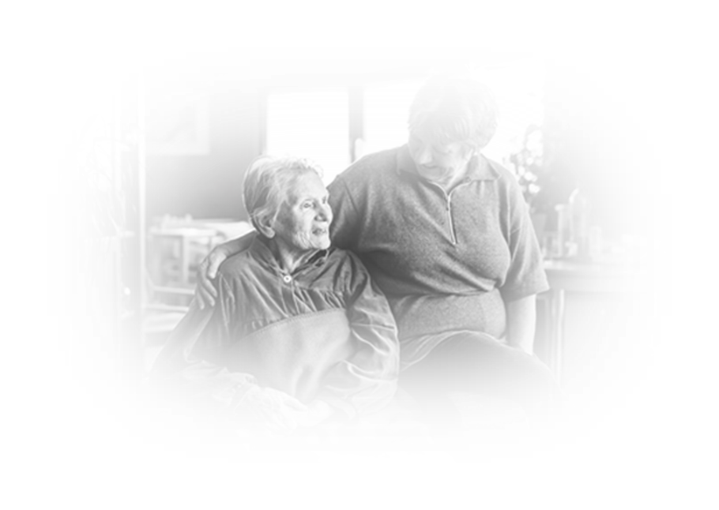
Dignity, Health and Independence
Reconciliation of Care and Work
Paid care leave/part-time care
  1-3 month -> up to 1 year
Family hospice leave/family hospice part-time
As long as hospice time
Care leave benefits basically equal to rate of unemployment benefit
Care Hotline (Pflegetelefon)
Platform for caring relatives (pflegedaheim.at)
Database on therapeutic aids (hilfsmittelinfo.at)
Support for 24 hour care
1.100.- € for employed and 550.- € for self-employed care persons
Educational background to that of home helps
TAKING ACTION ON SOCIAL INCLUSION OF OLDER PEOPLE

Slide 10
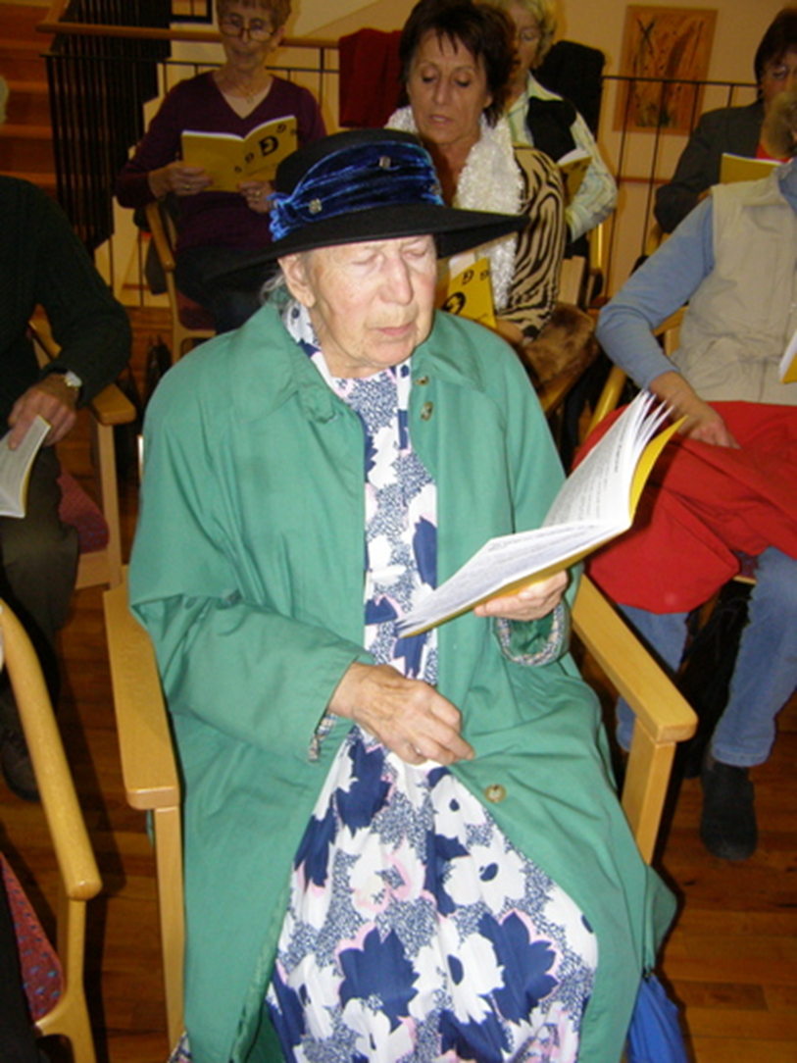
Dignity, Health and Independence
2017 National Strategy on Dementia
1,5 % of Austrian Population
National Quality Certificate for Nursery Homes
Information and counselling in the case
of violence against older persons
Parliamentary Commission
“Dignity at the end of life”
Since 2013 Extension of hospice and palliative care
in all provinces
Report on the Situation of Very Old People
Nov. 2018 International Conference on the Rights of Older Persons
* Robotics and Automation – Implications for Human Rights
* A Life-long Learning Process – Digitalization and Education
TAKING ACTION ON SOCIAL INCLUSION OF OLDER PEOPLE
TAKING ACTION ON SOCIAL INCLUSION OF OLDER PEOPLE

Slide 11
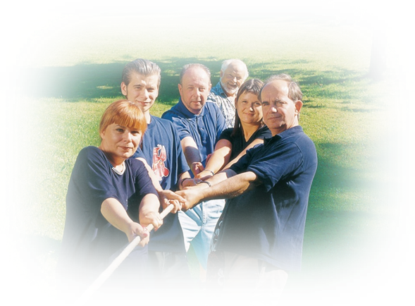
Solidarity between Generations
Federal Act on the Promotion
of Voluntary Work 2012
Council on Voluntary Work (2003)
Report on the Situation of Voluntary Work in Austria
Passport and Certificate on Voluntary Work
Information and Network-Platform www.freiwilligenweb.at
Framework and social security for participants of Voluntary Social Year,
Environmental Year, Social Year Abroad, Austrian Holocaust
Memorial Service, European Voluntary Service
TAKING ACTION ON SOCIAL INCLUSION OF OLDER PEOPLE

Slide 12
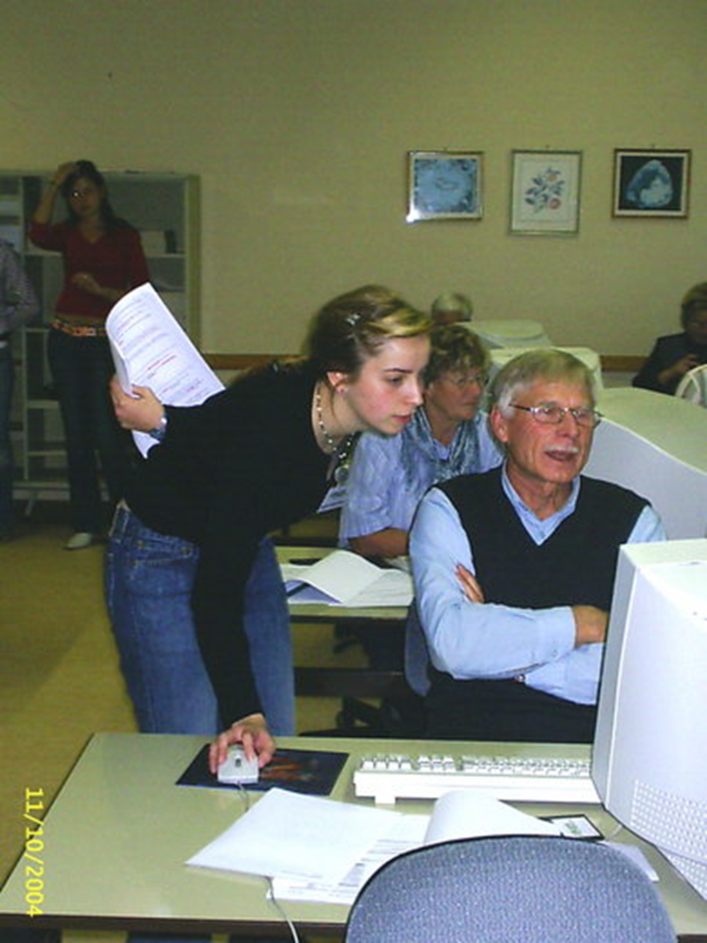
Solidarity between Generations
20 Volunteer Centers
Matching offers and demand
Lobbying and counselling
Training for volunteers and coordinators
Quality assurance in organizations
Initiatives and projects
“Computerias” young people introduce older persons in ICT
Guidelines for intergenerational projects
Brochures, calenders, voluntary fares
Tribute to Volunteers and Awards
Pilot Projects - Target groups: older persons, intergenerational projects, new forms of volunteering
TAKING ACTION ON SOCIAL INCLUSION OF OLDER PEOPLE

Slide 13
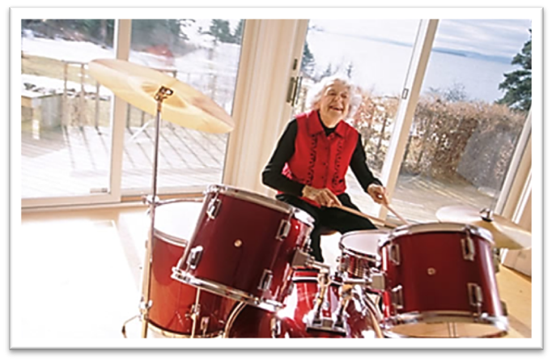
Thank you for your kind attention! erika.winkler@sozialministerium.at
We do not stop playing because we grow old
We grow old because we stop playing.
(G. B. Shaw)

