Slide 1
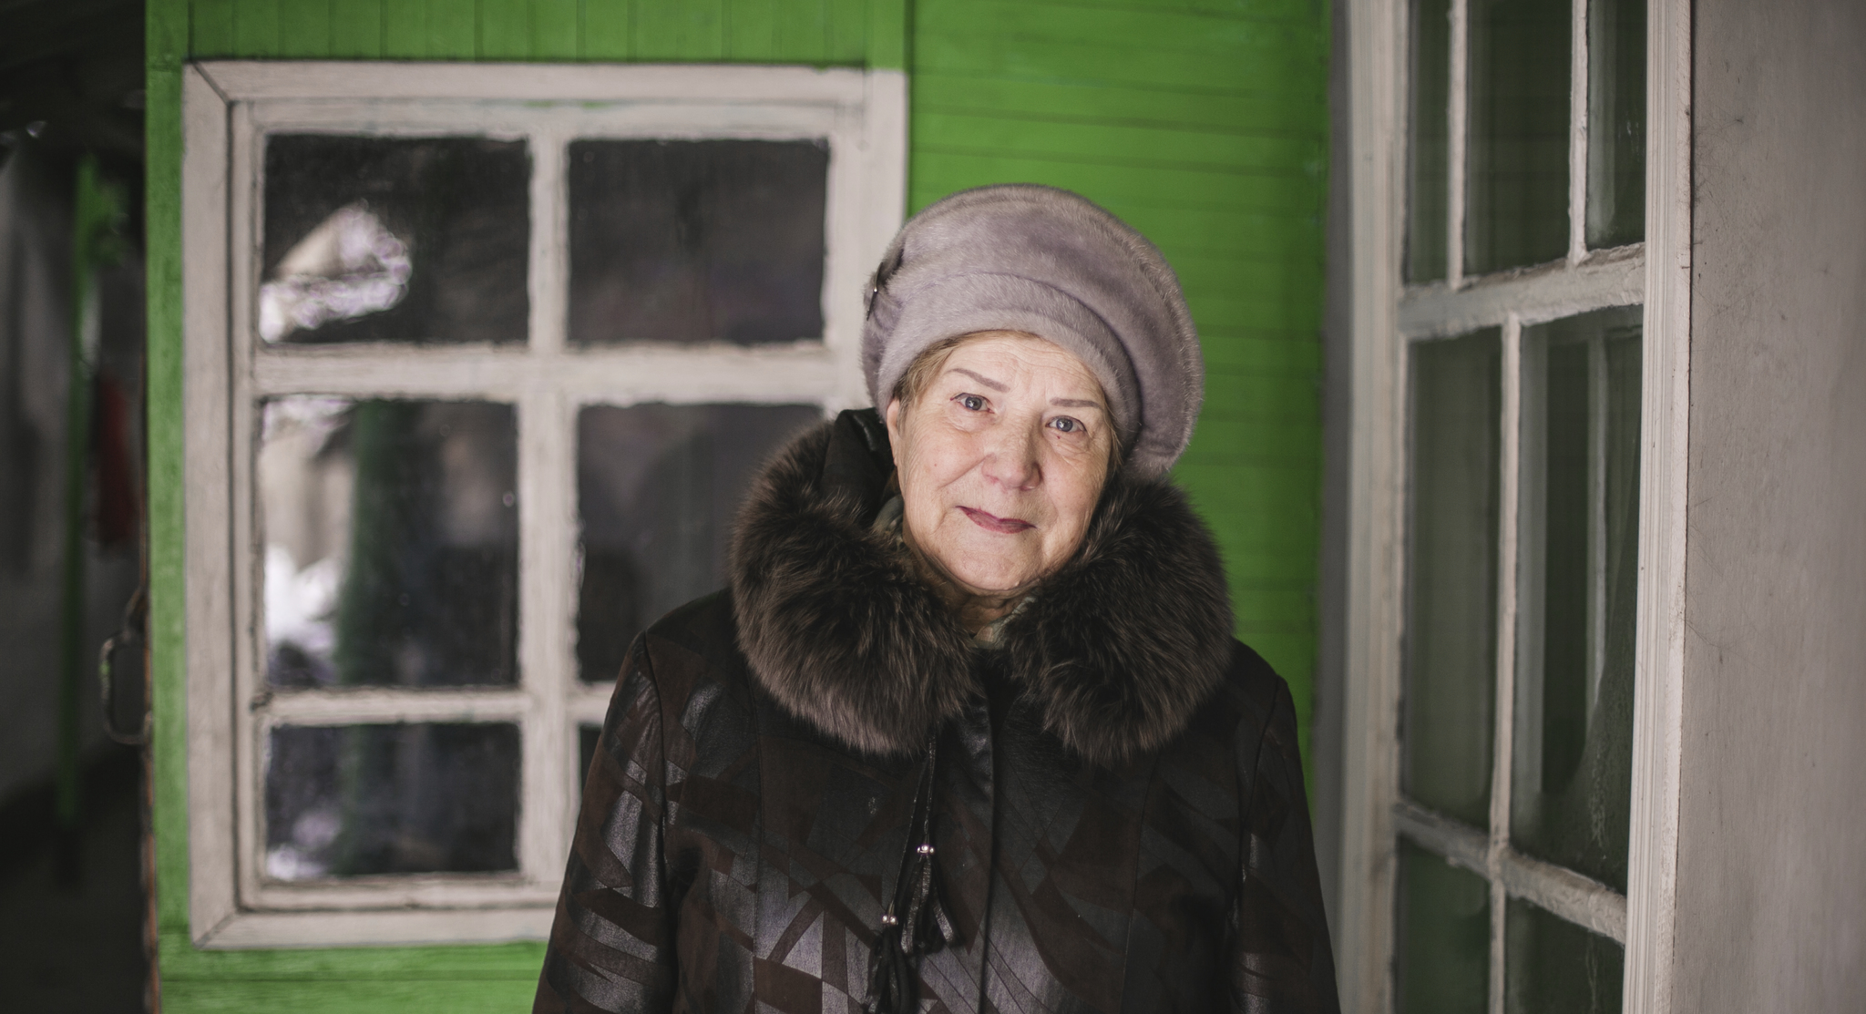

Ageing, Older Persons
and the 2030 Agenda
Notes:
I am the Agenda 2030 Advocacy Manager for HelpAge International
I would like to talk to you all about the SDGs, the opportunities they present to advance policy and practice in relation to ageing and older people
Some of what I’ll be talking about is the work we and others have done to secure a place for ageing and older people within Agenda 2030 at the global level
I’ll also be covering the challenges we are encountering now we are in the implementation phase as we aren’t yet seeing the SDGs deliver for older people at national level but I think there’s a role for everyone here in the room, whether you are grom civil society, a government or a multilateral institution, to change that.

Slide 2

Sustainable Development
Goals
Replace and build on Millennium Development Goals
Integrate economic, social and environmental development
Pledge to leave no one behind
Commitment to data disaggregation
17 goals and 169 targets
Notes:
Quick refresher about what the SDGs are to get us all on the same page
Read slide
Most people will be aware that the millennium development goals didn’t offer much for older people. Very focussed on specific diseases and specific population groups and the global monitoring framework also excluded them.
SDGs much more inclusive agenda underpinned by human rights
Integrate economic, social and environmental development
Central pledge to LNOB and connected commitment to data disaggregation in the monitoring of 17 goals and 169 targets
LNOB is critical - Main message is really normative: Older people can and should be included in implementation. This is a rights based framework. Older people have an equal right to development and equal access to all of the rights that the SDGs seek to realise older people
Demographic argument for governments to include older people

Slide 3
Why is it critical older people are part of SDG implementation?
Guiding government action
The SDGs will have a major impact on development thinking and practice to 2030
Explicit and implicit inclusion of older people
Key policy areas
Offers mechanism to mainstream ageing and older people into policy and to hold governments to account
Notes:
Practically speaking - slides
Guiding donor priorities, government action – lots of alignment happening.
Offers mechanism to mainstream ageing and older people into policy and to hold governments to account on the inclusion of ageing and older people in policies, programmes and budgets

Slide 4
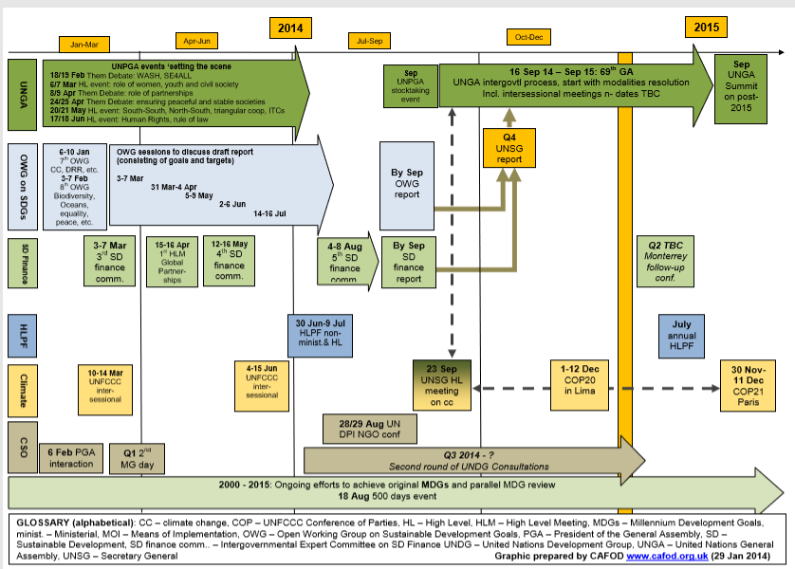
The global process
Notes:
This is something that we’ve made quite a lot of progress getting recognition of at the global level – don’t want to dwell too much on the global level but I think it’s useful to know what progress was made there because it can be replicated at the national level
This is a graphic produced by CAFOD just covering the process in the last two years of negotiations to give you an idea of how complicated the process was.
At the beginning - There really wasn’t much discussion about older people at that level when it came to sustainable development. Told we had no hope.
Told we had no hope.
Started engaging as individual NGOs – difficult to be heard. One of the challenges was a lack of a coordinated voice for older people. Since the earth summit in 2002, there had been a system of the UN coordinating with civil society via a system of major groups when it came to sustainable development issues – nine groups. None for older persons.
Came together as the Stakeholder group on Ageing and took a seat alongside the major groups.
Early on the pledge to LNOB became a very central theme and that opened doors – created a new mandate for others
With consistent and persistent engagement as a coordinated group, and the shift in environment, we were able to break through. Hard to pin point what exactly our contribution was, what was others and what was sheer luck.

Slide 5
Older people in the framework
2.2 By 2030, end all forms of malnutrition, including achieving, by 2025, the internationally agreed targets on stunting and wasting in children under 5 years of age, and address the nutritional needs of adolescent girls, pregnant and lactating women and older persons
11.2 By 2030, provide access to safe, affordable, accessible and sustainable transport systems for all, improving road safety, notably by expanding public transport, with special attention to the needs of those in vulnerable situations, women, children, persons with disabilities and older persons
11.7 By 2030, provide universal access to safe, inclusive and accessible, green and public spaces, in particular for women and children, older persons and persons with disabilities
Notes:
So what is in the framework?
Firstly, some specific mentions.

Slide 6
Older people in the framework
SDG3 Ensure healthy lives and promote well-being for all at all ages
10.2 By 2030, empower and promote the social, economic and political inclusion of all, irrespective of age, sex, disability, race, ethnicity, origin, religion or economic or other status
17.18 By 2020, enhance capacity-building support to developing countries, including for least developed countries and small island developing States, to increase significantly the availability of high-quality, timely and reliable data disaggregated by income, gender, age, race, ethnicity, migratory status, disability, geographic location and other characteristics relevant in national contexts
Notes:
Some mentions of age
Not many as you can see.
Put this in as it is useful for you to know what the specific mentions are but I would encourage you to not focus on those too much because they are quite limiting and there are more useful aspects.

Slide 7
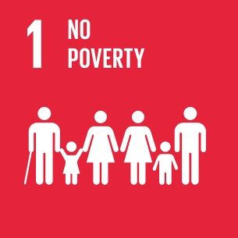


Income
SDG 1 End poverty in all its forms everywhere.
Target 1.1 By 2030, eradicate extreme poverty for all people everywhere, currently measured as people living on less than $1.25 a day.
Target 1.2 By 2030, reduce at least by half the proportion of men, women and children of all ages living in poverty in all its dimensions according to national definitions.
Target 1.3 Implement nationally appropriate social protection systems and measures for all, including floors, and by 2030 achieve substantial coverage of the poor and the vulnerable.
Notes:
Moving on from specific mentions, the SDGs also cover key policy issues for older people.
I’ll just cover some examples. Lisa has shared a useful mapping that will be discussed later.
Firstly, income security.
There is a welcome implicit inclusion of ageing in the first two targets and their indicators, which specify both that they should be disaggregated by age, and the fact that social protection also appears prominently under this goal.
Decent work also covered under goal 8.

Slide 8


Health and care
SDG 3 ensure healthy lives and promote well-being for all at all ages
Target 3.3 By 2030, end the epidemics of AIDS, tuberculosis, malaria and neglected tropical diseases and combat hepatitis, water-borne diseases and other communicable diseases
Target 3.4 By 2030, reduce by one third premature mortality from non-communicable diseases through prevention and treatment and promote mental health and well-being
Target 3.8 Achieve universal health coverage, including financial risk protection, access to quality essential health-care services and access to safe, effective, quality and affordable essential medicines and vaccines for all
Target 3.c Substantially increase health financing and the recruitment, development, training and retention of the health workforce in developing countries, especially in least developed countries and small island developing States
Notes:
The is a broader approach to health in the SDGs than the MDGs, and in particular the inclusion of a specific goal (SDG 3) focussed on health, to ensure healthy lives and promote well-being for all at all ages.
A wide range of targets addressing the spectrum of diseases including NCDs and the systems and infrastructure needed to ensure health and wellbeing also mark a step forward.
Focus on Universal Health Coverage (UHC) in the SDGs provides an opportunity to address a range of barriers to accessing health and care services

Slide 9
Discrimination, violence and abuse
Target 5.1 end all forms of discrimination against women and girls everywhere
Target 5.2 eliminate all forms of violence against all women and girls in public and private spheres, including trafficking and sexual and other types of exploitation
Target 10.3 Ensure equal opportunity and reduce inequalities of outcome, including through eliminating discriminatory laws, policies and practices and promoting appropriate legislation, policies and actions in this regard
Target 16.1 Significantly reduce all forms of violence and related death rates everywhere
Notes:
Strong focus on inequalities in SDGs. There is a stand alone goal on this and targets throughout. There are targets directly dealing with violence also.
.

Slide 10
Voice and accountability
Target 5.5 ensure women’s full and effective participation and equal opportunities for leadership at all levels of decision-making in political, economic, and public life
Target 10.2 By 2030 empower and promote the social, economic and political inclusion of all irrespective of age, sex, disability, race, ethnicity, origin, religion or economic or other status
Target 16.7 Ensure responsive, inclusive, participatory and representative decision-making at all levels
Notes:
Various targets in the framework that speak to voice and accountability.
In addition to the targets, there is a broader pledge to leave no one behind which is closely associated with the question of voice.

Slide 11
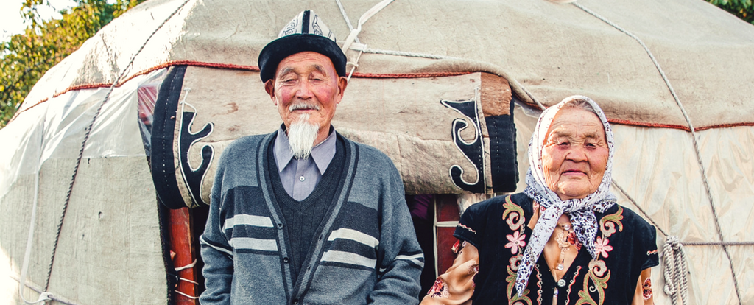
Broader significance
Commitment to leave no one behind
Creating new spaces and structures
Changing our operating environment and “disrupting” the systems we are used to operating in
Helping to take ageing and older people into the mainstream
Notes:
We have the mentions, some of the policy areas covered. We can use both of those to make progress in specific policy ares.
What we have found is that there is a broader opportunity that the SDGs present to have more transformational impact and take ageing and older people into the mainstream policy discourse, building on this commitment to LNOB.
SDGs have had a fundamentally disruptive impact
Created new spaces and structures
Changed the operating environment
Given us the opportunity to raise issues of ageing and older people in the political/executive space where SDG implementation is led from.
Opportunity to take our agenda into mainstream discourse (needs more systematic/strategic engagement but potentially a big pay off in terms of priority)
What we found at the global level was that we didn’t need to be limited to what was possible before because the SDGs have changed the rules of the game.

Slide 12


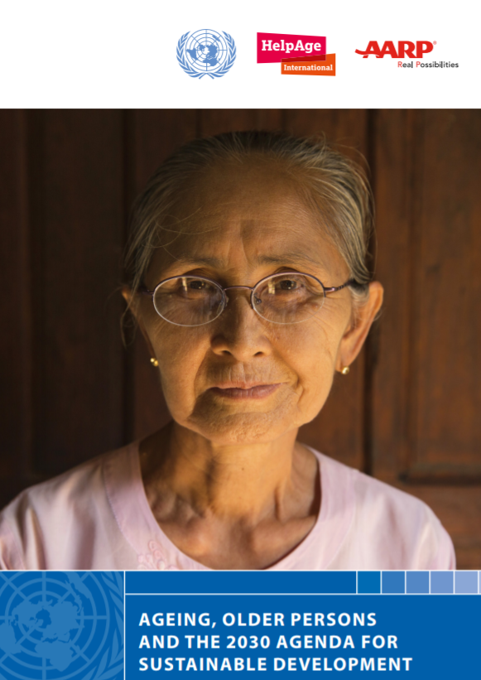

Notes:
Examples of how the impact at global level is already spilling out
UNDP
Titchfield
Regional mechanisms

Slide 13
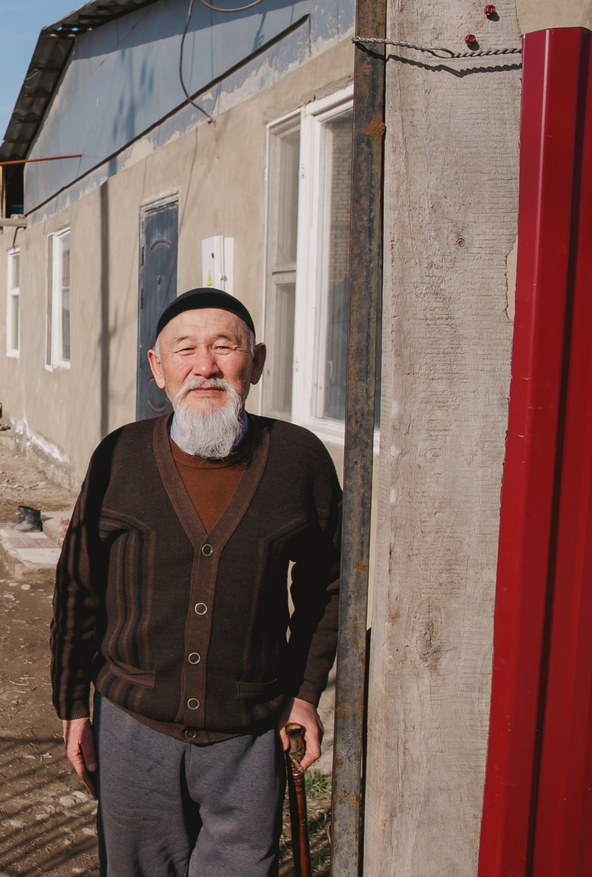
Ongoing challenges
Older people not seen as part of the picture
Understanding and engagement with SDGs among older people and their organisations
Lack of institutional space for ageing older people
Low priority afforded to older people – lack of understanding, will, data
Lack of governments championing this issue
Continued lack of recognition in wider development
Notes:
As much as we have made progress at global level, and as much as we see the relevance for older people, they are often not seen as part of the picture when it comes to SD priorities
From our work with the HelpAge network, we know there are gaps in understanding around the SDGs in relation to ageing/op among older people and their organisations and that this is a barrier to engagement with the process
Impact – lack of institutional space for older people – changing at regional level and some examples also at national level
Matched by
Low priority
lack of understanding on how to include older people, lack of political will and lack of data that is necessary to address these issues
At the global level, there are no governments championing older people within this process – suggests that more needs to happen at national level
However, much of the impact is still limited to the global space and still mostly on the civil society and UN side.
Solution – greater engagement at national level
On the civil society side, we as NGOs and networks are doing what we can with the resources that we have to mobilise civil society
There is a clear role for ageing focal points also. Potentially useful for you in terms of raising the profile of your issue, securing new commitments and pushing ageing up the policy agenda. Also has a knock on effect if we start to see that bubbling up to the global level because it has an impact on other governments and on the UN system and helps us to secure further commitments and advance the agenda at that level.

Slide 14
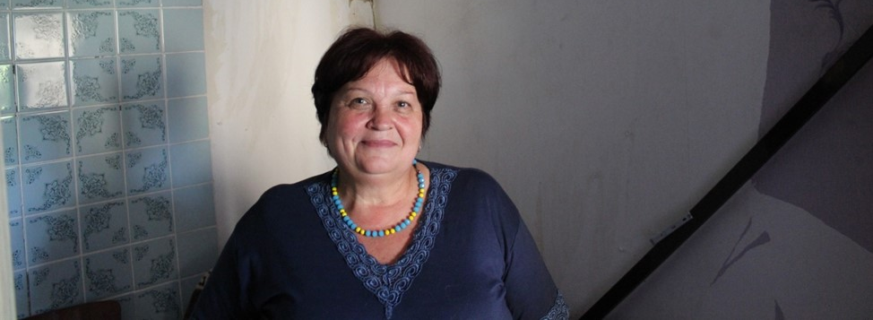
Making progress
Proactively with the planning, implementation and monitoring process
Through voluntary national reviews
In regional fora
Notes:
VNRs 2019 – Serbia, Bosnia,
2018 – Albania
2016 – Montenegro
Macedonia hasn’t volunteered yet.
Ways to make progress and take advantage of opportunities
1 – proactively ensuring older people are a part of the discussion when it comes to planning, implementation and monitoring of the SDGs. We can do that as civil society but also as representatives of governments and ML organisations.
There is a clear role for ageing focal points in making progress. For those of you focused on MIPAA implementation, SDGs useful for you in terms of raising the profile of your issue, securing new commitments and pushing ageing up the policy agenda.
2 - Every year a number of countries volunteer to report at the HLPF. Next year Serbia and Bosnia Herzegovina will report. Ahead, there is a process of consultation to prepare the report – useful entry point.
3 – participate in regional fora. Help us get to a critical mass.
Also has a knock on effect if we start to see that bubbling up to the global level because it has an impact on other governments and on the UN system and helps us to secure further commitments and advance the agenda at that level.
Follow up and review process organised around an annual High Level Political Forum in July
Voluntary national reports are prepared in advance through a consultative national process
Regional Preparatory meetings

Slide 15
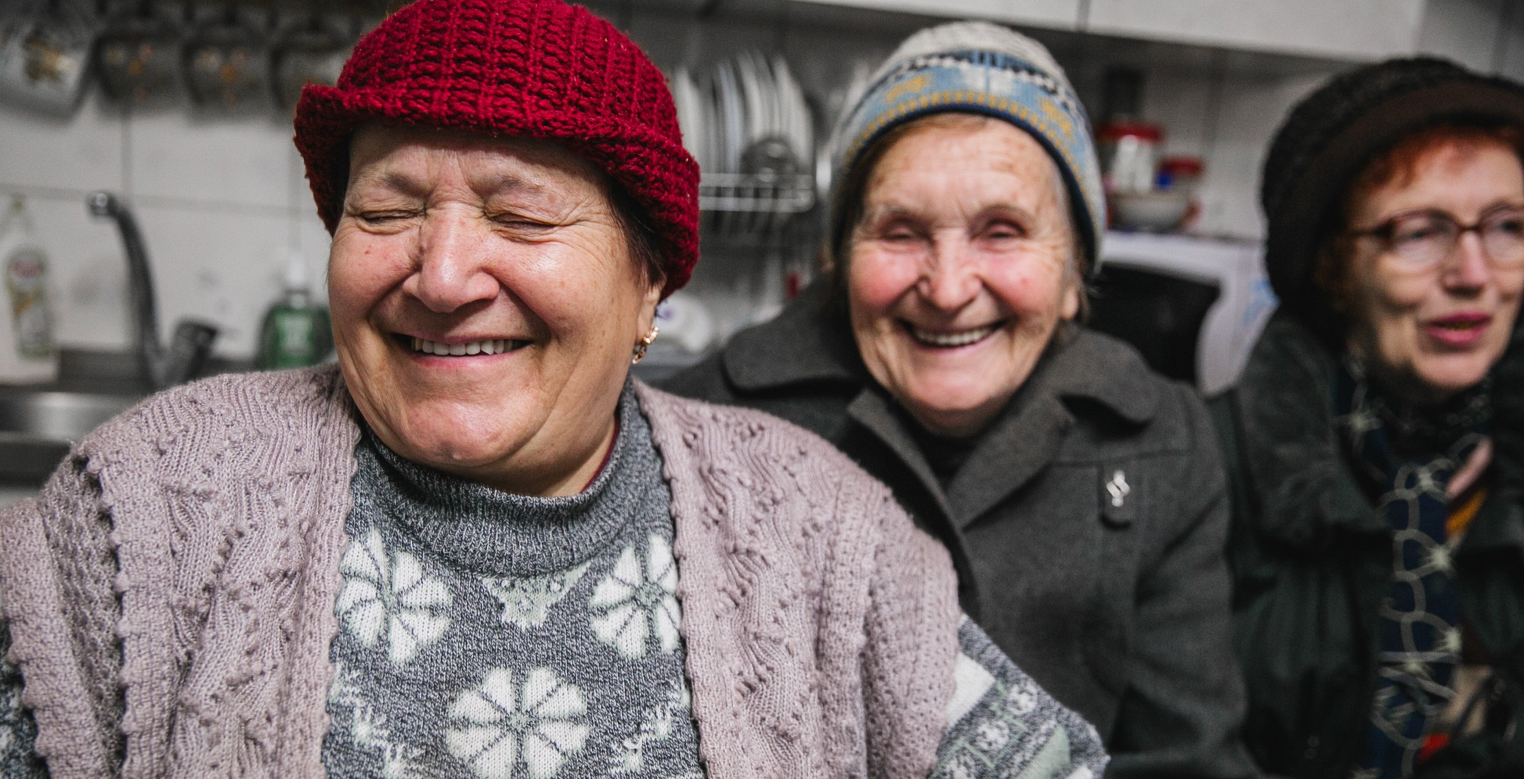
Thank you
Verity.mcgivern@helpage.org
Notes:
Thank you for listening. I’ll conclude there, urging you to consider how you can play a role in ensuring that we capitalise on the opportunities that the SDGs present for older people.

