Slide 1


How ageism affects
our human rights in older age
The #AgeingEqual campaign experience

Slide 2
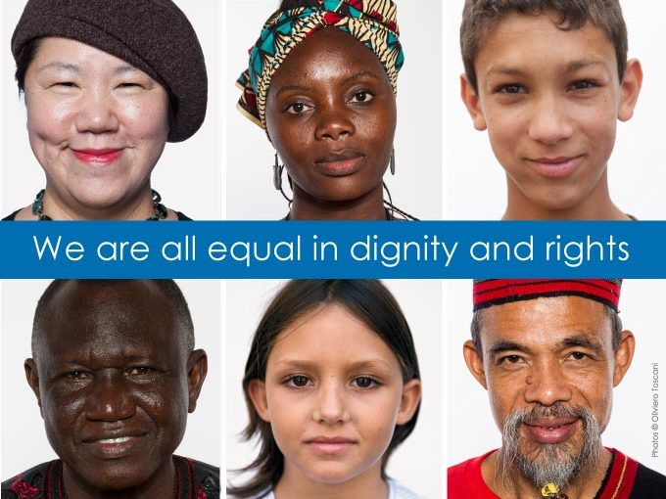
Principle of Equality (Art. 2, UDHR)
“Everyone is entitled to all the rights and freedoms set forth in this Declaration without distinction of any kind such as race, color, sex, language, religion, political or other opinion, national or social origin, property, birth or other status”

Slide 3
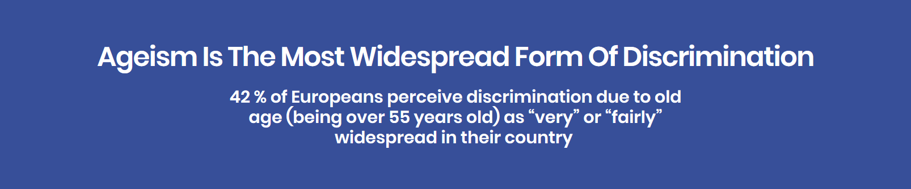
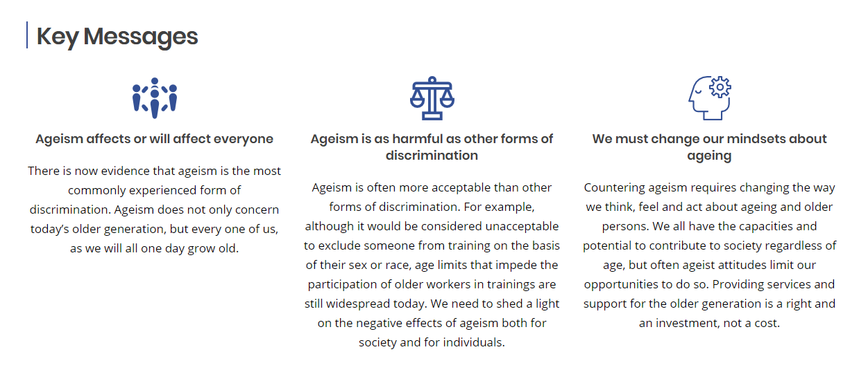
In Practice…

Slide 4
Unlike other forms of discrimination,
ageism is socially accepted and usually unchallenged, because of the subconscious internalisation
of ageist prejudices.
UN Independent Expert on the Enjoyment
of all Human Rights by Older Persons

Slide 5
The #AgeingEqual campaign

Slide 6
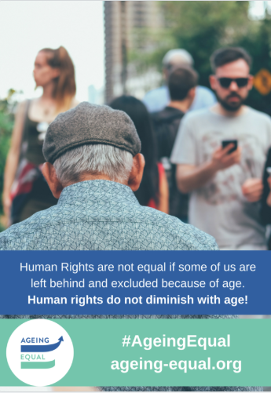
#AgeingEqual objectives
Raise awareness of ageism
Establish a community
of anti-ageism activists
Initiate new collaborations
Infuse other policy dossiers
Notes:
#AgeingEqual campaign objectives
Raise awareness of the magnitude and gravity of ageism
Establish a long-lasting community of activists and a platform for action against ageism
Initiate new collaborations for an intersectional approach to ageing
Infuse other policy dossiers with a human rights perspective

Slide 7
1.
What is ageism?

Slide 8
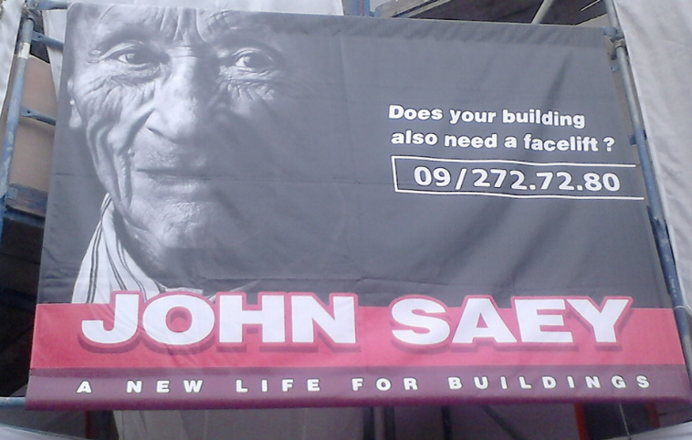
Is this ageist?

Slide 9
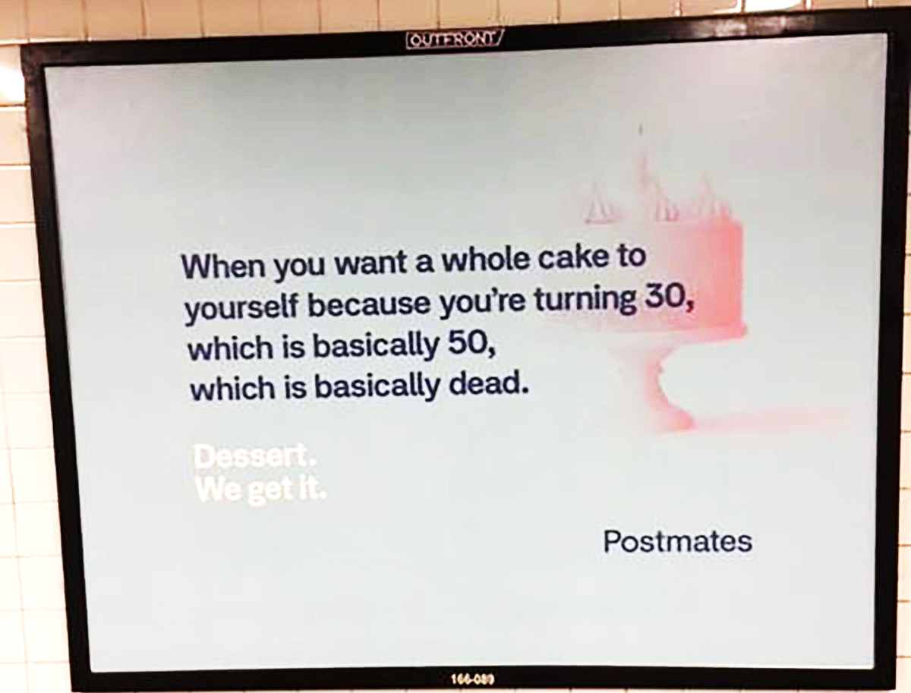
And this?

Slide 10
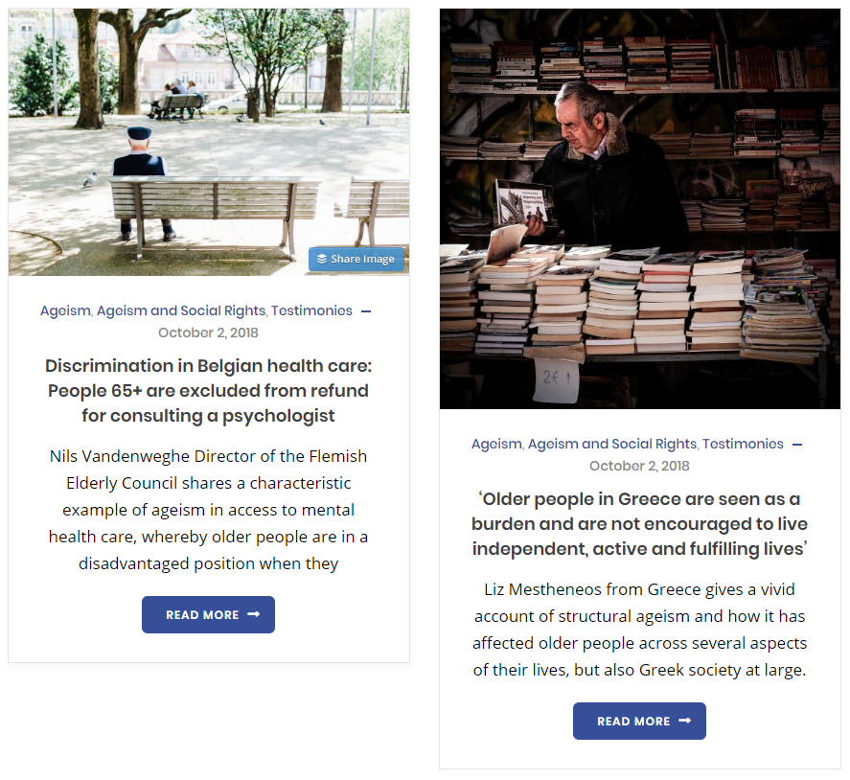
And this?

Slide 11
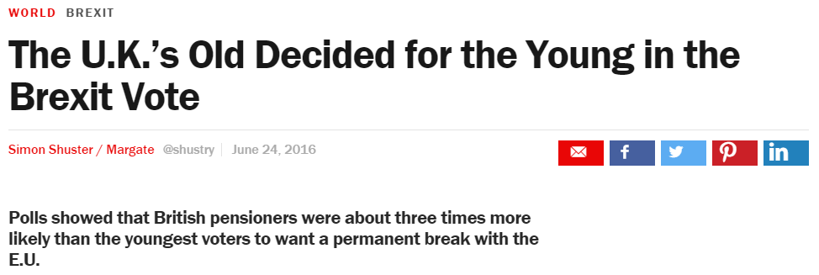
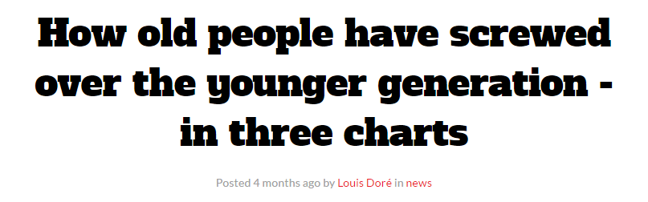
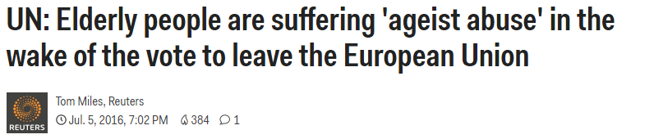
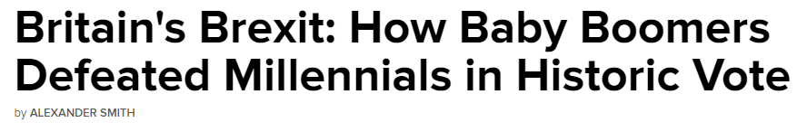
And this?

Slide 12
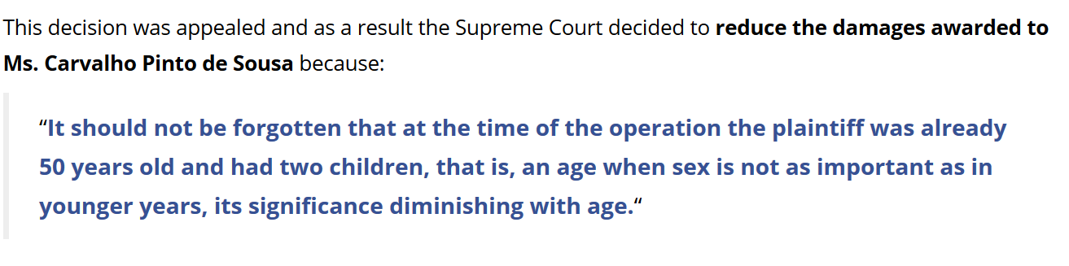
And this?

Slide 13
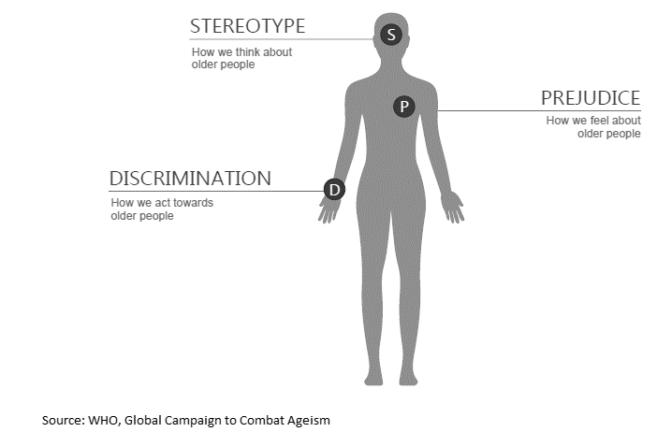
Three dimensions

Slide 14
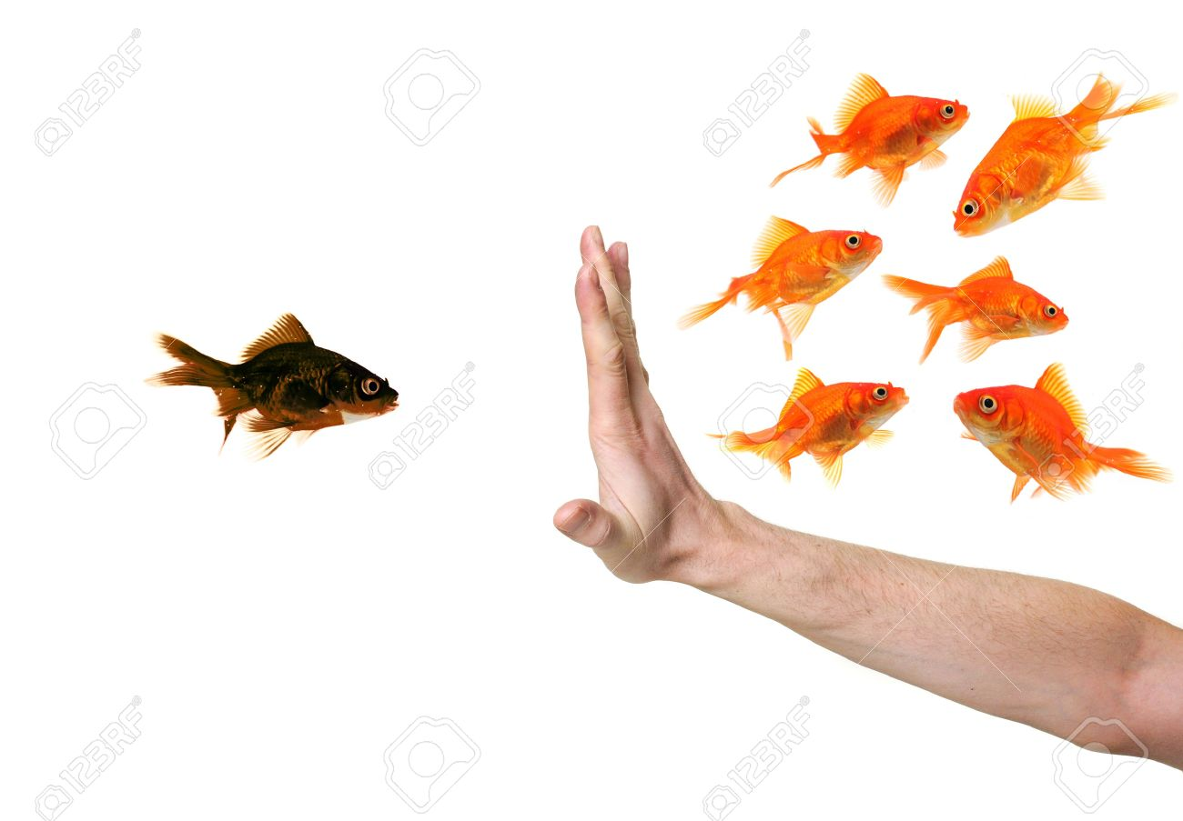
A process of ‘othering’
Notes:
Aristotle – likes should be treated alike, unlikes should be treated differently in proportion to their unlikeness.
Are older people in a comparable situation with other adults when it comes to the right to work? Education? Is there a legitimate reason to exclude them from rights that are available to other adults?
Or perhaps because older people are nearing the end of their life, are less productive, etc it is ok to restrict some of their human rights? In other words are assumptions about one’s capacity to work or to learn legitimate reasons for differential treatment? Is it ok to exclude all older people from preventive health screening because of limited resources? Or should we instead be using other criteria like financial means to rationalise the use of public resources?

Slide 15
The consequences of ageism
“Although the Universal Declaration on Human Rights proclaims that all human beings are born free and equal, it is evident that the enjoyment of all human rights diminishes with age, owing to the negative notion
that older persons are somehow less productive,
less valuable to society and a burden to the economy
and to younger generations.”
UN Open-Ended Working Group on Ageing, 2017
Notes:
Absence of age discrimination laws
Exceptions
Lack of scrutiny about age limits in law and unfair treatment in practice → ex. training
Self ageism → not claiming rights
Lack of information and support
Biased decisions by courts

Slide 16
On our health and wellbeing
Undermined memory, sense of autonomy and self-esteem
Cardiovascular stress and reduced life expectancy (by 7.5 years)
On our capacity to contribute to society
Denied access to educational opportunities, trainings and work
Struggle to exercise political rights (e.g. inaccessible polling stations)
Reduced social engagement and increased late-life loneliness
On our chances to live a life free from abuse
One third of the 8500 annual homicides of older persons in Europe
are the result of elder maltreatment

Slide 17
That are tougher for some groups
1/3 older LGBTI report having a mental health problem at some time in their lives
28% Share of older women have experienced some kind of violence or abuse in the previous 12 months
25% of older Europeans with high care needs suffer maltreatment
40% Gender pension gap
Black minority ethnic are diagnosed with dementia 4.5 years younger than their white counterparts
Roma people will die
10 to 15 years earlier
than most Europeans

Slide 18
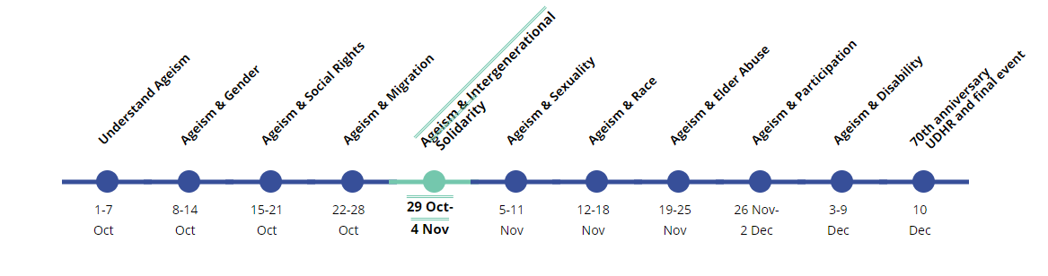
For more information: www.ageing-equal.org
Notes:
The prohibition of discrimination in older age should not be subject to a wider range of exceptions than is permitted for any other ground.

Slide 19
2.
What have we done together?

Slide 20
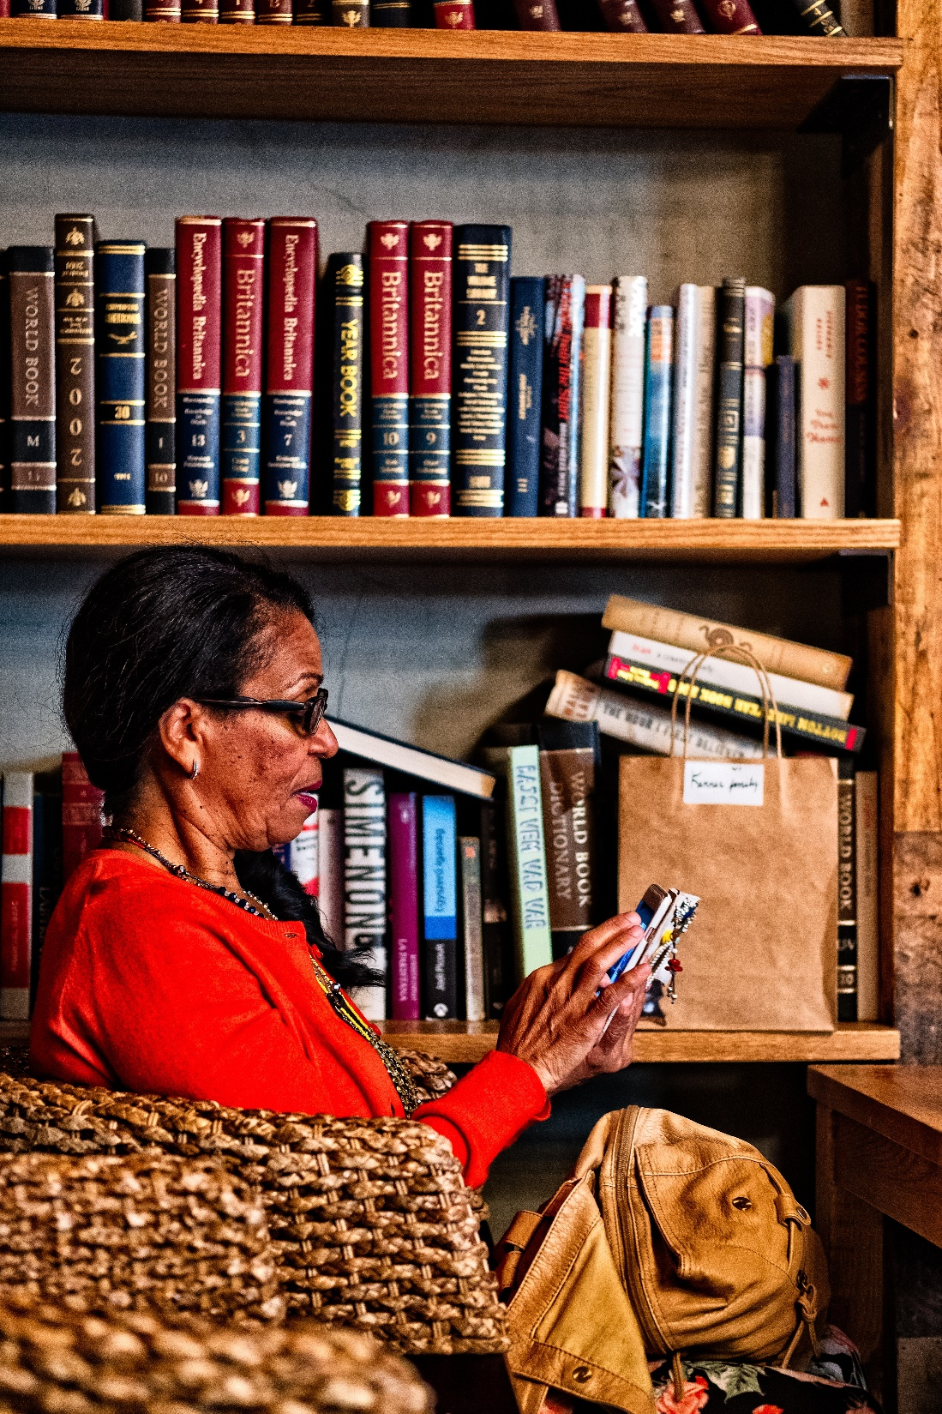
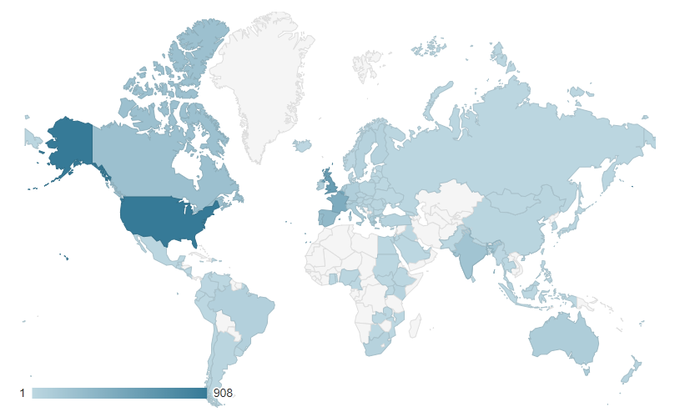
The campaign in figures
In less than 10 weeks…
+70
Blogposts
+30
Testimonies
+30
Good practices
19.5K pages views on ageing-equal.org
Hundreds of tweets with #AgeingEqual
+500K views of AGE tweets
A campaign shared in various European countries and beyond!

Slide 21
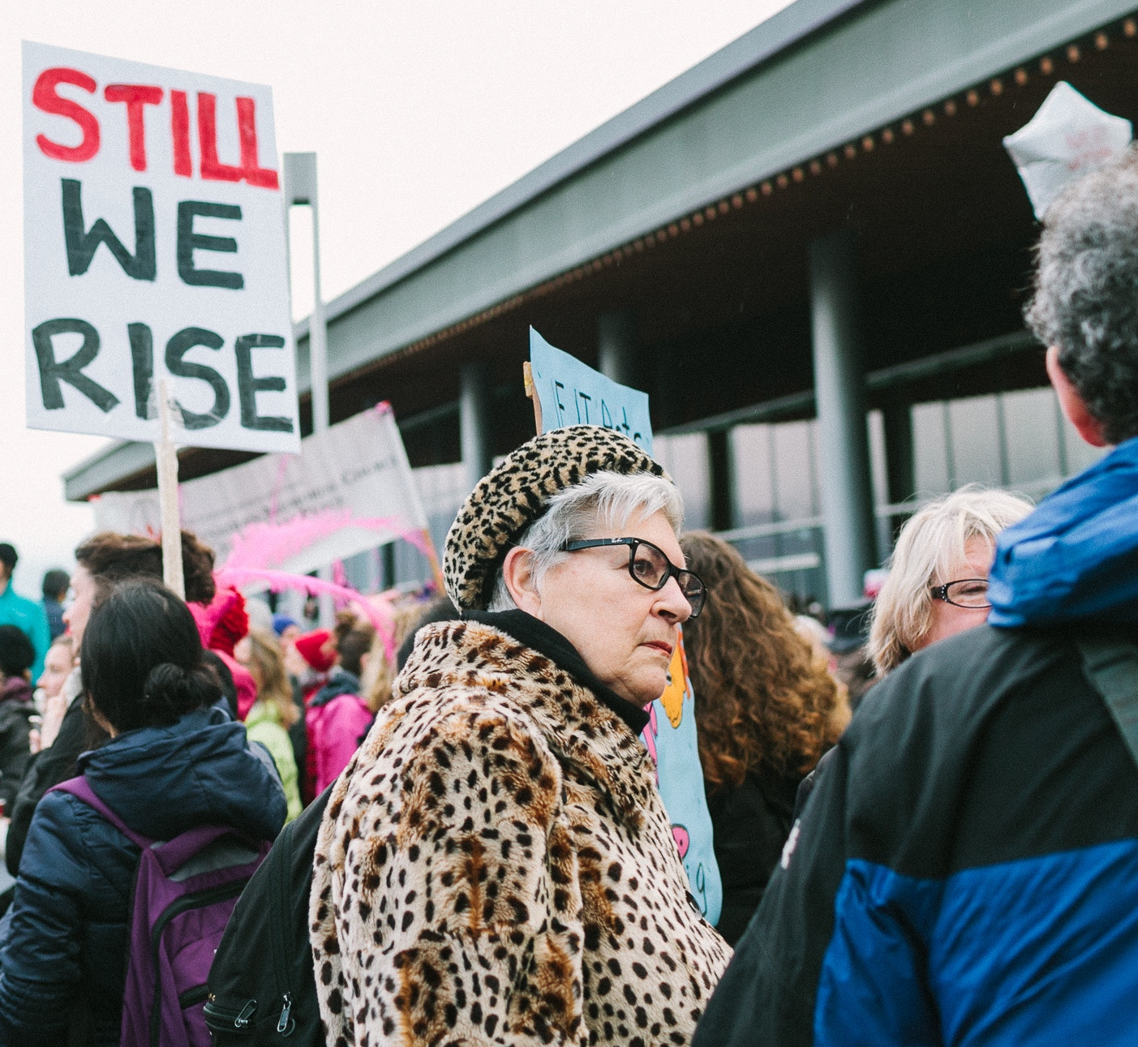
Empowerment
through
campaigning
Relate to experience
Share good practices,
tools and tips
Develop a sense of belonging to the group
Be aware of our capacities
of collective action

Slide 22
3.
What are the next steps?

Slide 23
Next steps
In the long-run
Push for a paradigm shift towards a human rights approach that focuses on the empowerment of older persons and valorisation of their capacity to live independently and contribute to society

Slide 24
Next steps
In the long-run
Push for a paradigm shift towards a human rights approach that focuses on the empowerment of older persons and valorisation of their capacity to live independently and contribute to society
Sustain the newly established community of activists so we eventually achieve to reach this critical mass that is necessary to address discrimination and human rights violations

Slide 25
Next steps
In the long-run
Push for a paradigm shift towards a human rights approach that focuses on the empowerment of older persons and valorisation of their capacity to live independently and contribute to society
Sustain the newly established community of activists so we eventually achieve to reach this critical mass that is necessary to address discrimination and human rights violations
Mainstream ageism to address it in intersection with other discrimination faced by different groups in society

Slide 26
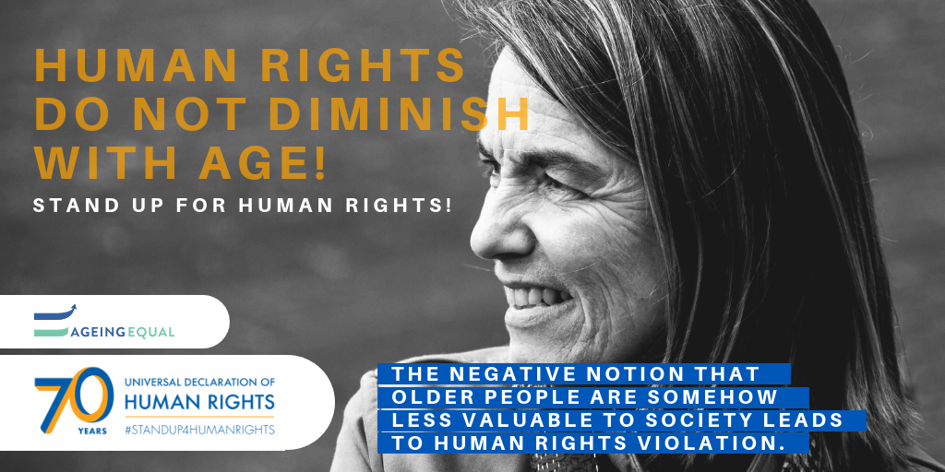

Slide 27
THANK YOU!
estelle.huchet@age-platform.eu

